Slide 1
Chiropractic’s Role in Perinatal Mood & Anxiety Disorders
John “doc” Edwards, dc, daccp, Perinatal Certified,
SpBap, ITB II, brain Dc completion

Slide 2
What are we going to learn today?
Hour 1: PMADs: Establishing the problem
Hour 2: Screening for cortical low tone
Hour 3: Addressing low tone in the office and at home
Hour 4: Considerations for Sympathetic vs Parasympathetic adjusting & the Social Vagus.

Slide 3
Keep handy…
Penlight (You can use your phone’s flashlight on the lowest setting)
Pen and a piece of paper
Space around your chair for standing & moving

Slide 4
Making a Case for Family Wellness Chiropractors to be “Home Base”
PostPartum Support (PSI)
Allied Health professionals
Letter To Provider
Fill in the blanks

Slide 5
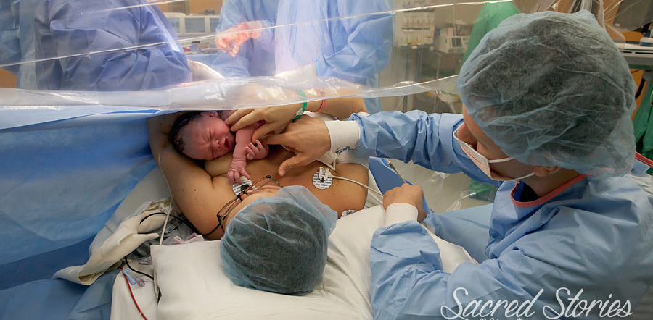
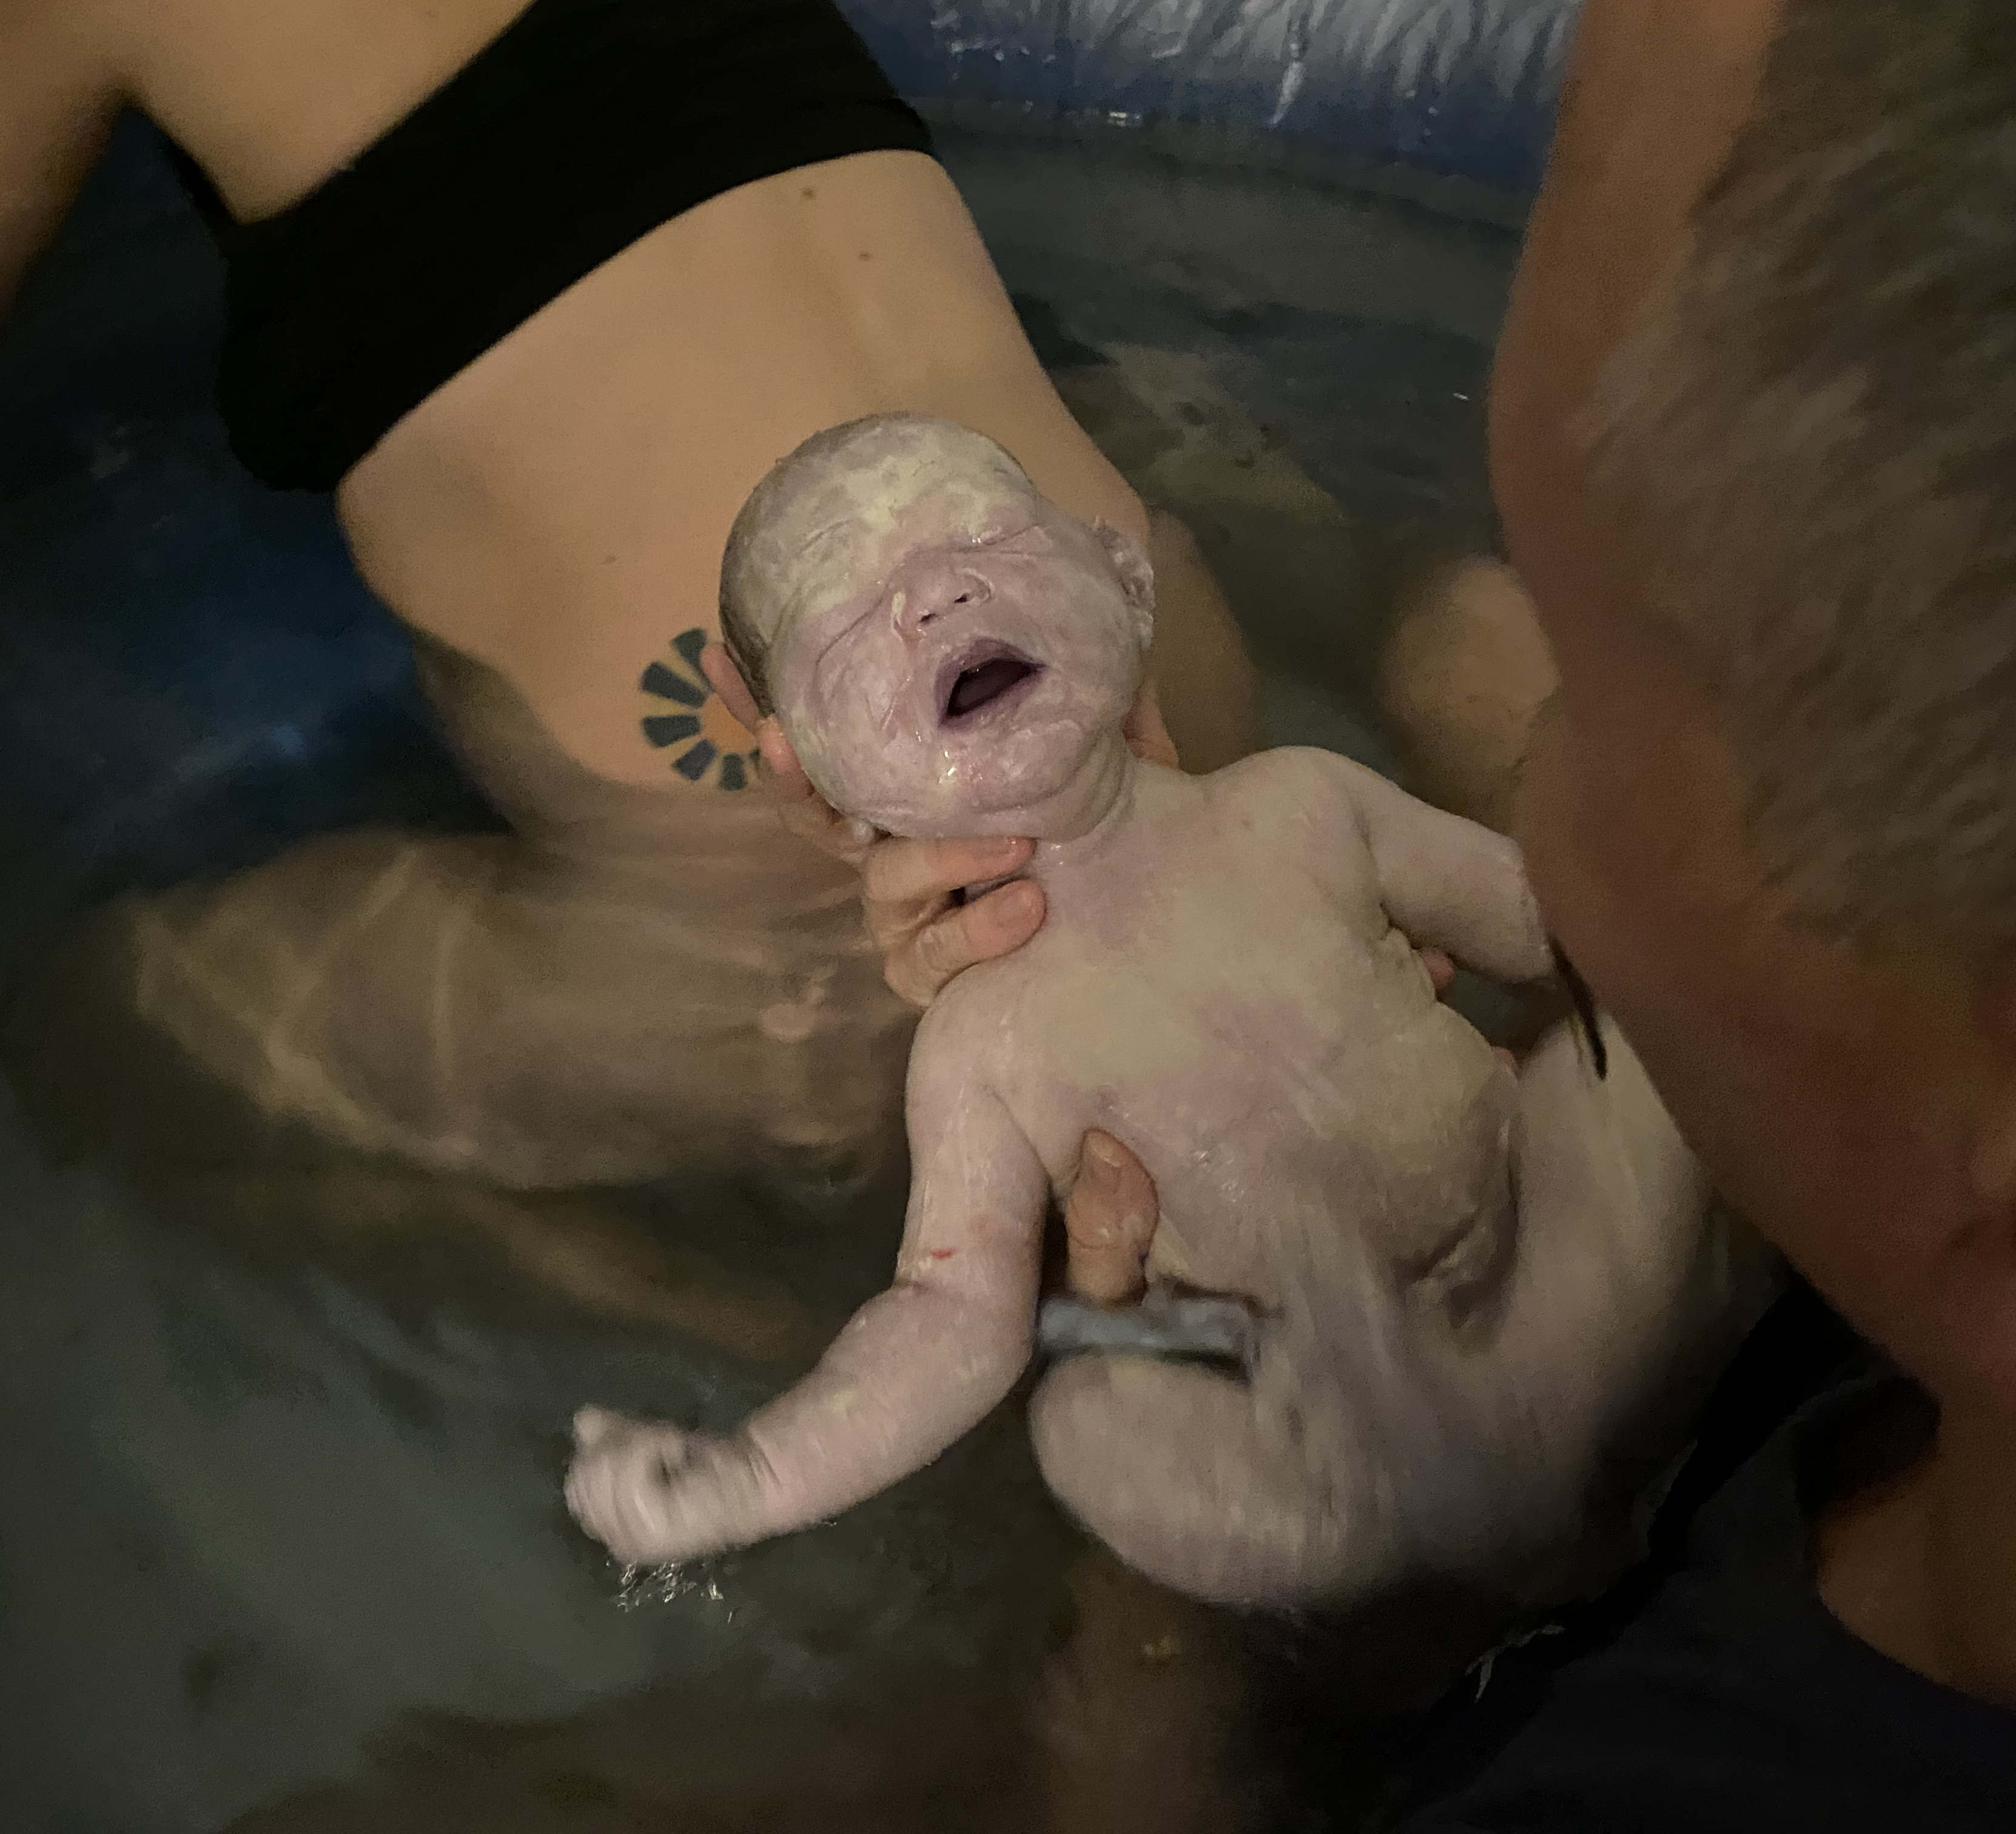
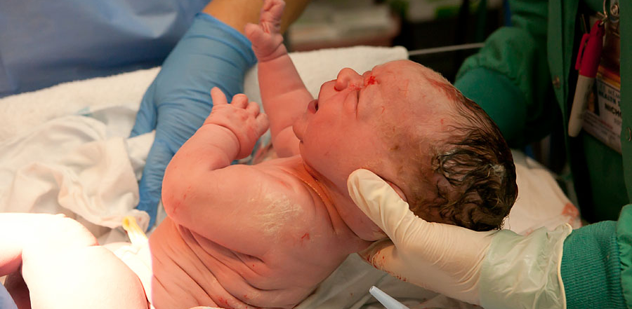
A Tale of Two Brothers
Forrest 12/17/2015
Charlie 02/16/2021

Slide 6
My First Clue I was Missing Something In Practice
The Chiropractic Care of a Patient with Harrington Rods, Scoliosis & Back Pain During Pregnancy JMFPH

Slide 7
“You Can’t Manage What You Can’t Measure”- Peter Drucker
PROMIS-29
Rand VSQ
Edinburg Postnatal Depression Scale (EPDS)
Depression Anxiety Stress Scale (DASS)
The Quality of Life and Patient Satisfaction of Pregnant Women Under Chiropractic Care, Journal of Chiro Ed 2018

Slide 8
Male Brain vs Female brain
Male Brain | Female Brain
More Neurons | More Connections
Fight/Flight | Tend/Befriend
Blood Pressure | Heart Rate/ Breathing Rate
Power | Endurance
Motor Neuron Disease | Connectivity/Autoimmune Disease

Slide 9
Pregnancy Care: Perinatal Functional Outcome Assessment
Posture
Functional Neuro Exam
QOL
P-SIJH/Category II
Instrumentation

Slide 10
Do We Own Subluxation?
What’s the best way to detect it?
What’s the best way to clear it?
Are they able to be cleared?
Do you have new entities or recurring established ones?
What’s the best way to prevent them from recurring?
Are they a normal course of human existence or a pathology?
How often do they occur?
Are there other systems related to their presence?
Can you predict who is more likely to be prone to them?

Slide 11
Drywall Contractors vs Electricians?
Active Frontal Lobes Inhibit Flexor Tone
“Default” state of SCM, Trapezius, Suboccipital Triangle, Medial Rectus, & Multifidi is flexion.
Good brains inhibit that by 12 months as the frontal lobes develop, which also helps us stand upright.
Active Frontal Lobes Inhibit Sympathetic Nerve System Activity
“Default” position ANS is Sympathetic for survival. Pupils dilate to “see” everything.

Slide 12
To jog your brains
The cortical (Frontal, Parietal, Temporal) Lobes get fed by their opposite side cerebellum.
Neurons like oxygen, glucose, and activity
Activate the side of cerebellar low tone, or opposite the side of cortical low tone, through adjustments

Slide 13
Right Brain vs Left brain
Right Brain | Left Brain
Creative | Rational
Joy & Contentment | Happiness
Optimism | Pessimism/Realism
Regulates the Immune System
Posture | Arms & Legs

Slide 14
Pregnancy Care: Perinatal Functional Outcome Assessment
Posture
Functional Neuro Exam
QOL
P-SIJH/Category II
Instrumentation

Slide 15
Perinatal Functional Outcome Assessment
Posture
Head tilt- to high flexor/low neuro tone side, or high point is the active cortex

Slide 16
Perinatal Functional Outcome Assessment
Posture
Head tilt: to high flexor/low neuro tone side, or…
high point is the active cortex

Slide 17
Perinatal Functional Outcome Assessment Functional Neurology Examination
Assessing ANS Tone through the eyes
Hypermetric
Hypometric

Slide 18
Assessing Cortical Tone
Eye Motion
Pupillary Latency
Convergence
Accommodation
Pursuits: Horizontal, Diagonal, Vertical
Saccades: Horizonal, Vertical

Slide 19
Building the LLL Case for “Low Tone”
Horizontal Pursuit
Hypometric
Same Side Parietal
Opposite Cerebellum
Hypermetric
Opposite Cerebellum

Slide 20
Building the LLL Case for “Low Tone”
Diagonal Pursuit
Hypometric
Up-side Cerebellum
Hypermetric
?

Slide 21
Building the LLL Case for “Low Tone”
Horizontal Saccades
Hypometric
Opposite Frontal
Same Cerebellum
Hypermetric
Same Cerebellum

Slide 22
Building the LLL Case for “Low Tone”
Low Cortical Tone
Head Tilt/ High Shoulder
Pupillary Latency
Poorly Converge
Hypotonic Pursuit
Hypotonic Saccade (opposite)
……

Slide 23
Perinatal Functional Outcome Assessment Functional Neurology Examination
Assessing ANS Tone through the eyes
Hypermetric
Hypometric
What would low tone in the left PTO look like?
Stress in the right frontal lobe?

Slide 24
Assessing Cerebellar Tone
Coordination Tests (Dyskinesisa)
Eyes Open/Eyes Closed
Finger to Nose
Random Finger to Nose
Dysdiadochokinesis
March (Homo/Heterologous)
Fukuda-Unterberger (> 20”)

Slide 25
Perinatal Functional Outcome Assessment: Advanced Romberg and Stork Stand
Unilateral Stance Norms
99th percentile: 30 sec
70th percentile: 20 sec
Sub 50th: 15 sec
Performance of Unipedal Stance Static Balance Test by Pregnant Women Under Chiropractic Care. Journal of Chiro Ed 2018

Slide 26
Building the LLL Case for “Low Tone”
Low Cerebellar Tone
HYPERtonic Field of Gaze
HYPOtonic Fields of Gaze
Bad Diagonal Pursuits
Dysmetria
Dyskinesia
Poor Balance

Slide 27
Assessing ANS Tone Through Vitals
Blood Pressure
Heart Rate
Respiratory Rate
Pulse Oxygenation
Chest Expansion
Heart Rate Variability

Slide 28
Perinatal Functional Outcome Assessment:Muscular Endurance
Wall Sit (up to 28 weeks, or 90 days postpartum)- Single leg, goal at PP is performance.
1 sec better than 0!
Total right and left leg
99th percentile is 30 sec
3 min step test

Slide 29
Building the LLL Case for “Low Tone”
Low Cortical Tone
Head Tilt/ High Shoulder
Pupillary Latency
Poorly Converge
Hypotonic Pursuit
Hypotonic Saccade (opposite)
SYM ANS
Low PO2

Slide 30
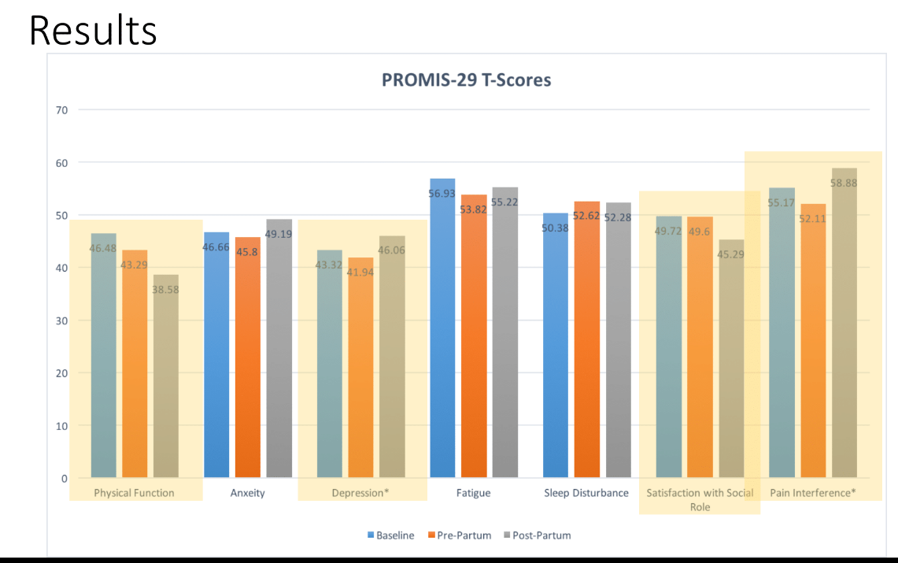
Functional Goals: Beyond Floors & FHC
Perinatal Mood Disorders:
Postpartum Depression/
Anxiety/
Anger/
Psychosis

Slide 31
Clinical Application of Cortical Balancing Activities
Right Cortical Low Tone: Left Panning, Core & Erectors, Squats
Left Cortical Low Tone: Right Panning, Laterality, Squats
Cerebellar Low Tone: Balance, Coordination, Squats

Slide 32
Panning
First Determine Side of Cortical Laterality (Low Tone)
Panning is going to be done with the hand opposite of that
“Airplane Hitch hiker”
Lead with the eyes
Can be done Standing or Prone on a ball

Slide 33
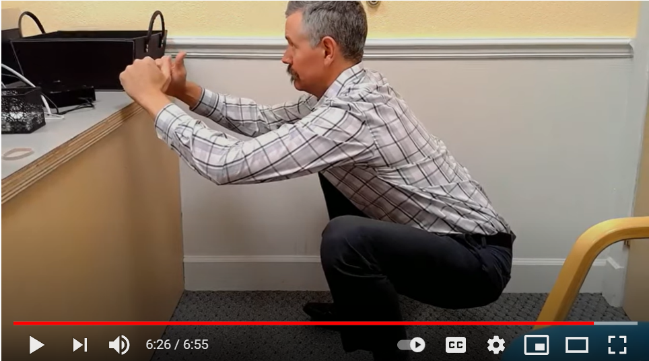
Vertical Shin Squat
Big Toe, Little Toe, and Heel In the ground like claws
Vertical Shins, Knees DO NOT travel over the toes
“Pinch Point” at the hips is a cue to abduct & externally rotate the thighs
Knees spread out to the sides
Maintain neutral pelvis
Torso Up
May need a box/chair to begin with

Slide 34
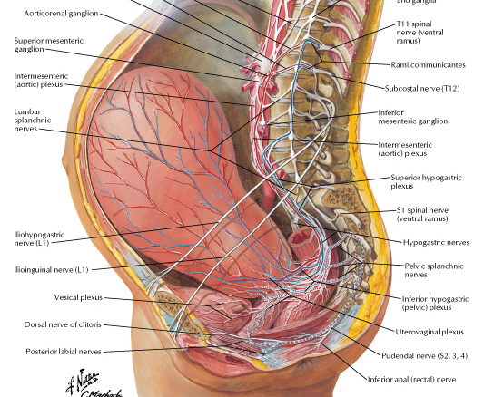
Does it Matter?
Considerations for Sympathetic vs Parasympathetic Adjusting

Slide 35
Rubric for Sympathetic vs Parasympathetic Adjusting
Parasympathetic | Sympathetic
Broad Palate | Narrow Palate
Low Activity | Highly Active
Low HR/RR | High HR/RR
Good Digestion/Expression | Poor Digestion/Expression
Tendency to Depression | Tendency to Anxiety
Maintains Contractions | Gives Labor a Kick!

Slide 36
The Polyvagal Imperative
Braden, Dispenza, & Lipton in “The Panel That Changed the World”

Slide 37
Delta Wave Programming and You
Polyvagal Theory- Steven Porges, PhD
Delta- Subconscious
Alpha- Creative
Beta- Rational

Slide 38
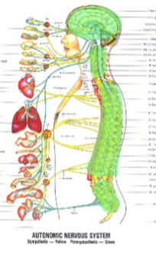
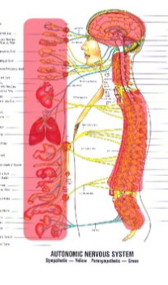
Delta Wave Programming and You
Social Vagus- Hey Mom! (Dunstan Baby Language)
Sympathetic Vagus- Mom! Mom! Mom!
Parasympathetic Vagus- Let’s see how this goes...

Slide 39
Creating Community: Pick 12 Adult Ed & Family Events

Slide 40
For Monday Morning
6 Minute Recap: https://youtu.be/U8R-4w5TE90
More on Latency, Convergence, Accommodation: https://youtu.be/MgX_rMIZt6o
Squats: https://youtu.be/xv4ewk2wYcQ?t=240

Slide 41
ICPA Statement of Purpose
What if there were an organization that recognized your own unique expression and human potential? What if that same organization represented the most highly trained practitioners who could provide specific, gentle care so that you could function at your greatest capacity? What if this organization of practitioners knew how to care for children by honoring women throughout their pregnancy and motherhood?
Imagine if doctors truly supported a woman's innate right to make informed choices for her own family. Imagine if a safe community of empowered parents existed to support a mother's inner guidance and the desire to grow.
These are the principles and promises of the ICPA and its community of 6,000 doctors of chiropractic. These 6,000 ICPA members have come together to serve families. Family is the heart and home of our human potential. The loving and gentle care of chiropractic for each individual strengthens the family, strengthens the community, and opens the possibility for a greater tomorrow.
Welcome to the ICPA and our avenue for bringing chiropractic principles into practice for a more purposeful and fulfilling family life.

Slide 42
If you’re drooly like me…
Join
Your Invitation to Upskill:
Learn more at an ICPA Seminar
Email
Send me an email: doc@seachangeseminars.com
FB/IG/YouTube
Send me a friend request/Follow:
John “Doc” Edwards
Subscribe to One Belly Two Brains
Visit
Come for a visit: Mama’s Chiropractic Clinics
Cape Coral | Fort Myers |North Port, FL
Donate
Support the ICPA’s Research Mission Donate & Earmark: “Perinatal Clinical Research”

