Slide 1
Ohio State Chiropractic Association Break Out Session Lower Extremity
Brendan M Murray DC, DACBSP

Slide 2
Goals
The goals for this course are to present a literature based approach for rehabilitation.
Take the evidence based information and implement it into daily practice.
Use your assessment skills to specifically create a rehabilitation protocol for each patient.

Slide 3
Mechanism of injury
Suboptimal loading Injury
Injury Pain
Pain Inaccurate movement
Inaccurate movement Suboptimal loading

Slide 4
Hip Injuries
Common conditions:
Femoral acetabular impingement
Hip bursitis

Slide 5
Hip Injuries
FAI;
Possible causes:
Cam Impingement
Pincer Impingement
Hyperflexion
Hyperextension
Circumduction(Waterpolo)

Slide 6
Femoral Acetabular Impingement Syndrome

Slide 7
Diagnosis of FAI
Diagnostic accuracy for FAI syndrome can be improved when results from both hip impingement and range of motion tests are considered
AIMT(Anterior Impingement test): the examiner brings the hip into 90° of flexion and then moves the hip into internal rotation and adduction;
Palsson, A et al Combining results from hip impingement and range of motion tests can increase diagnostic accuracy in patients with FAI syndrome, Knee Surg Sports Traumatol Arthrosc. 2020; 28(10): 3382–3392.Published online 2020 Apr 25. doi: 10.1007/s00167-020-06005-5

Slide 8
Diagnosis of FAI
FADIR: the examiner brings the hip into maximal flexion, internal rotation and adduction

Slide 9
Diagnosis of FAI
FABER: the examined leg is placed with the foot just proximal to the contralateral knee joint,
The hip is moved into a combined flexion, abduction and external rotation position.
The examiner places a hand on the contralateral side of the pelvis to minimize pelvic rotation;

Slide 10
Diagnosis of FAI
Adding in Range of Motion test
Neutral hip range with internal rotation
Hip flexion to 90 degrees with internal rotation
Hip flexion to 90 degrees with external rotation and abduction
Along with positive Orthopedic test increased sensitivity and specificity.
Palsson, A et al Combining results from hip impingement and range of motion tests can increase diagnostic accuracy in patients with FAI syndrome, Knee Surg Sports Traumatol Arthrosc. 2020; 28(10): 3382–3392.Published online 2020 Apr 25. doi: 10.1007/s00167-020-06005-5

Slide 11
Diagnosis of FAI
Internal rotation with a neutral hip position

Slide 12
Diagnosis of FAI
Evaluated 35 patients diagnosed with FAIS pre-surgical
The mean age was 33.46 years for patients with FAIS (SD: 11.89; range: 16–56)
Used a 6 minute walking test which provoked the patients with FAIS
A functional test to add to the other test previously shown is a 6 minute walking test.
single leg hop , Biodex sway, hip abduction strength, and STAR excursion balance reach other tests performed but did not affect patients with FAIS
Nunley, B et al Relationships between self-perceived and clinical expression of pain and function differ based on the underlying pathology of the human hip, BMC Musculoskelet Disord. 2023; 24: 635.Published online 2023 Aug 7. doi: 10.1186/s12891-023-06768-1

Slide 13
FAI Images

Slide 14
FAI Images

Slide 15
FAI Images US

Slide 16
Hip Range of Motion
Larkin et al Clinical Orthopedics and Related Research 2014
They looked for the impingement-free hip ROM until the point of labral deflection and maximal femoral and acetabular abutment with musculoskeletal ultrasound?
40 adult males age 21 to 35, (80 hips) no history of hip or groin pain.

Slide 17
Hip Range of Motion
Larkin et al 2014 cont
Each subject underwent bilateral static and dynamic ultrasound examinations
13 subjects had a cam deformity, 3 bilaterally and 10 unilaterally.
What they were looking for is when the labrum went from a gently curved semicircular labrum in neutral position into a more boomerang-shaped labrum with hip flexion.

Slide 18
Hip Range of Motion
Larkin et al cont;
The impingement-free hip flexion in all 80 hips was 68 ± 17 degrees. In the cam type hip, labral deflection occurred at 63 ± 20 degrees.
The maximum flexion in all 80 hips was 96 ± 6 to bony abutment between the femoral head-neck junction and the acetabular rim.

Slide 19
FAI
Ross et al American Journal of Sports Medicine 2014
Retrospective study of 48 patients (50 hips) with symptomatic FAI who all underwent arthroscopic surgical procedures from June to August 2012.
Pre-surgical CT scans had been performed.
Mean age was 25.7(14-56), 56% males 54% were females

Slide 20
FAI
Ross et al cont;
10° anterior tilt resulted in a decreased femoral internal rotation 5.9°. FADIR test was positive sooner.
10° posterior tilt resulted in an increased internal rotation 5.1° and FADIR being positive later.

Slide 21
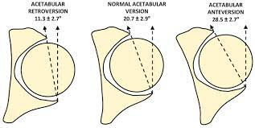

Slide 22
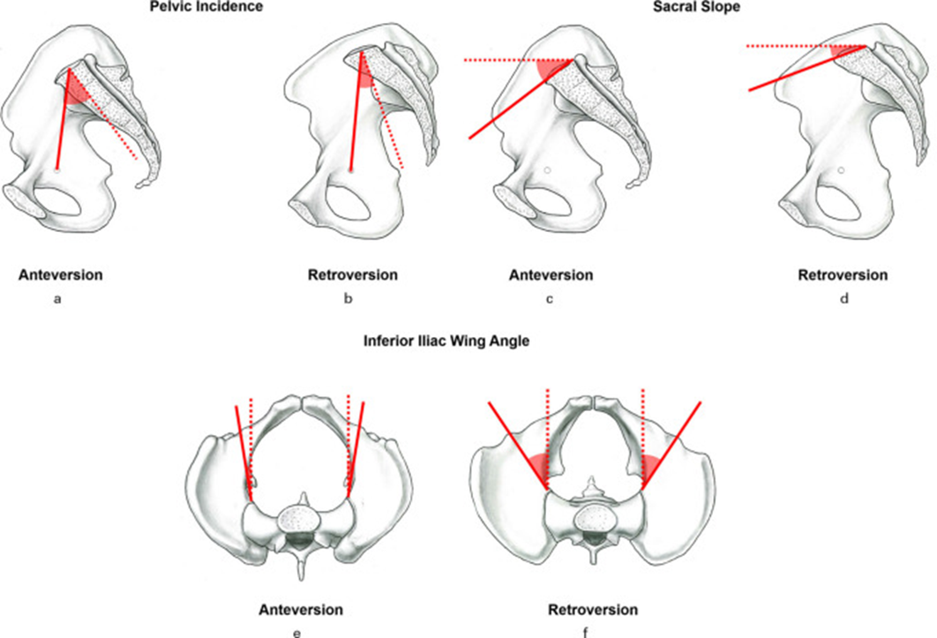

Slide 23
FAI
Ross et al cont;
“Rehabilitation for patient with FAI should include attempts to improve dynamic muscular control of the pelvis with resultant changes in pelvic tilt.”
In this study “the radiographic appearance of the anterior and posterior acetabular rims is significantly affected by the amount of pelvic tilt.”

Slide 24
Causes of FAI
Musielak B et al BMC Musculoskeletal Disorders 2016
Retrospectively evaluated 31 male patients who had surgery for FAI and using 3D CT scan
The purpose of the study was to evaluate the movement of a hemipelvis in FAI

Slide 25
Causes of FAI
Musielak B et al BMC Musculoskeletal Disorders 2016 cont:
As the hemipelvis moves anterior and laterally the acetabulum faces more caudally.
This movement of the hemipelvis creates an increase in anteversion of acetabulum.
Possible reasons to increase coverage posteriorly to prevent dislocation and prevent dynamic conflict with the femoral head anteriorly.
Schwarz J et al Effect of Pelvic Sagittal Tilt and Axial Rotation on Functional Acetabular Orientation, Orthopedics. 2023 Jan-Feb;46(1):e27-e30. doi: 10.3928/01477447-20221003-04. Epub 2022 Oct 6.PMID: 36206512

Slide 26
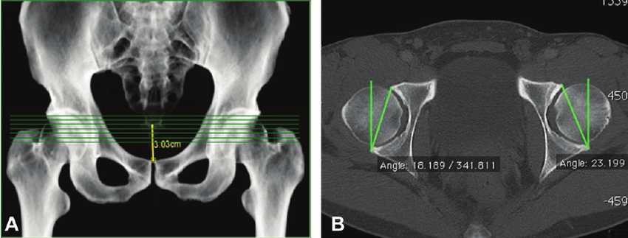
Rotation of the pelvis is going to change acetabular version one side to another.
Schwarz J et al Effect of Pelvic Sagittal Tilt and Axial Rotation on Functional Acetabular Orientation, Orthopedics. 2023 Jan-Feb;46(1):e27-e30. doi: 10.3928/01477447-20221003-04. Epub 2022 Oct 6.PMID: 36206512

Slide 27
Causes of FAI
Bagwell et al., 2016a; Lamontagne et al., 2009 2017; Ng et al., 2015,
Decreased ability of persons with FAIS to posteriorly tilt the pelvis during motions requiring large ranges of hip flexion, such as a deep squat

Slide 28
Causes of FAI
Azevedo et al., 2016; Lewis et al., 2018a; Lewis et al., 2018b; Rylander et al., 2013, Yin Qf et al 2021
Persons with FAIS have been reported to assume a relatively more anteriorly tilted pelvis compared to healthy controls
Most of the time, the pelvis has a synergetic tilt backward while hip flexing, which could prevent the contact cam lesion of the femoral head and acetabular rim.

Slide 29
Causes of FAI
Bagwell JJ et al Clinical Biomechanics 2019
Evaluated posterior pelvic tilt during a squat and non weight bearing hip flexion in patient with FAI vs non FAI
Patients with FAI decreased posterior pelvic tilt during the squat and non weight bearing hip flexion vs controls

Slide 30
Causes of FAI
Bagwella JJ et al Clinical Biomechanics 2019 cont;
We speculate that a lack of lumbopelvic mobility or hip joint capsular tightness is a potential cause of overall reduced pelvis motion.
Limited lumbopelvic mobility could be the result of tightness of soft tissues

Slide 31
Causes of FAI
Yin Qf et al 2021 Orthopedic Surgery, Fader RR et al 2018
Patients who complain of sitting pain have a decreased Pelvic Incidence(PI) and demonstrate less capability of pelvic tilting backward during sitting down compared to these without sitting pain complaint.
Insufficient pelvic tilting backward could be an aggravating factor for pain in symptomatic cam‐type FAI patients.

Slide 32
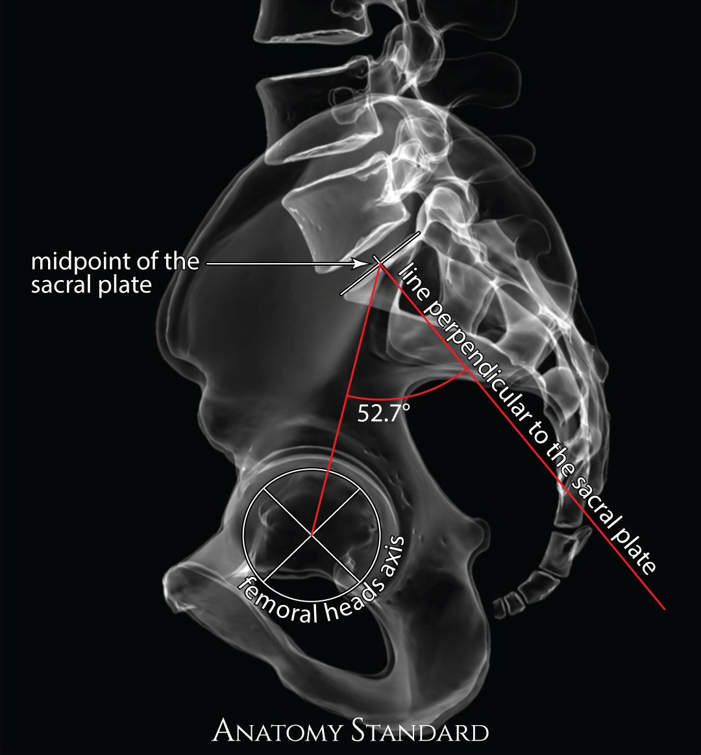

Slide 33
FAI and Gait
Diamond LE et al 2018 Gait and Posture
During stair ascent patients (with out pain) with FAI had ipsilateral torso lean to side of symptoms.
Patients who had pain during stair ascent had ipsilateral torso lean and pelvic obliquity (frontal plane) to the side of symptoms
Controls did not have any change in torso of pelvic position during stair ascent

Slide 34
FAI and Gait
Twenty four pain-free controls were compared against 41 participants with FAI syndrome
Compared to pain-free controls, participants with FAI syndrome walked with more trunk anterior tilt, as well as less pelvic rise, hip abduction and external rotation.
They also had lower hip flexion abduction and ankle plantarflexion moments. These biomechanical differences occurred throughout the gait cycle.
Savage TN et al, Trunk, pelvis and lower limb walking biomechanics are similarly altered in those with femoroacetabular impingement syndrome regardless of cam morphology size, Gait Posture. 2021 Jan;83:26-34. doi: 10.1016/j.gaitpost.2020.10.002. Epub 2020 Oct 10.PMID: 33069126

Slide 35
Bursa of the Hip
An average of 6 different bursa around the “Trochanteric bursa”
They found 4 under the Gluteus Maximus tendon and TFL
2 beneath the Gluteus Medius tendon
Woodley SJ et al Morphology of the bursae associated with the greater trochanter of the femur, J Bone Joint Surg AM2008 Feb;90(2):284-94. doi: 10.2106/JBJS.G.00257.

Slide 36
“Trochanteric Bursitis”
Often seen is runners, cross country skiers, ballet dancers, *football players, *soccer players, *rugby and *hockey players. (*The latter usually due to trauma)
Symptomatically: presents as a burning or a deep aching sensation over the inferior aspect of the lesser trochantor.

Slide 37
Patellofemoral Pain
Numerous authors have linked frontal and transverse plane motion of the hip and knee with patellofemoral joint contact stress.
(Fuchs, Schutte and Witte,1999, Powers et al 2003, Ramappa et al 2006, Salsich and Perman 2007, Wilson et al 2008, Souza RB. et al 2009, Powers et al 2009)

Slide 38
Patellofemoral Pain Syndrome
PFP (Patellofemoral Pain) results from irritation of innervated structures of the patellofemoral joint (ex., inflamed synovial and fat pad tissues) as a result of excessive joint loading.
This theory has led to the identification of factors that can lead to increased patellofemoral joint loading, such as (1) altered lower extremity kinematics and kinetics, (2) increased muscle strength and neuromuscular recruitment, (3)faulty structural alignment, and reduced flexibility
Dye SF et al Clin Orthop Relat Res. 2005, Bolgla LA et al Journal of Athletic Training 2018,

Slide 39
Patellofemoral Pain
Changes in the dynamic alignment of the lower limb creates pain and pathology in patellofemoral area.

Slide 40
Patellofemoral Pain
Ipsilateral trunk lean and contralateral pelvic drop
Increased hip adduction, hip medial rotation, hip flexion and knee valgus during weight bearing results in elevated joint stresses at the patellofemoral joint.
Nakagawa T, et al 2012

Slide 41
Patellofemoral Pain
Powers et al 2003, Souza et al 2010;
Females with PFP have a significantly greater lateral patellar displacement at 0, 15 and 30 degrees
Greater medial femoral rotation at 0, 15 and 45 degrees while doing a single limb squat in an MRI.

Slide 42
Patellofemoral Pain
Patella moves laterally while the distal femur goes medial

Slide 43
Patellofemoral Pain
Powers CM et al Medicine &Science in Sport 2015
9 females with Patellofemoral pain (PFP)
MRI evaluated loaded knee flexion at 15 degrees and 45 degrees
3D motion analysis standing squat at 15 and 45 degrees of flexion.
The purpose of this study was to evaluate whether internal rotation of the femur results in elevated patella cartilage stress in females with PFP

Slide 44
Patellofemoral Pain
Powers CM et al Medicine &Science in Sport 2015
Patella cartilage stress was significantly higher when the femur was internally rotated 5 and 10 degrees 26% and 36% respectively
Highest cartilage stress along lateral facets occurred at 45 degrees of flexion vs 15 degrees of flexion.

Slide 45
PFPS
Souza and Powers Am J Sports Med. 2009;
Found that reduced hip-extension endurance, not isometric strength, was the sole hip-muscle predictor of increased hip internal rotation during running in females with PFP

Slide 46
PFPS
Neuromuscular Factors:
Another possible contributor to PFP is a delay in activation of the VMO relative to the VL. The VMO and VL provide dynamic stabilization to the patella as it tracks in the femoral trochlea.
Therefore, an imbalance in the onset or activity level (or both) of the VMO relative to the VL could lead to patellar malalignment.
McConnell J. et al Sports Med Arthorsc Rev 2007; Witvrouw E et al Knee Surg Sports Traumatol Arthorsc 2005 Amer J Sports Med 2000; Van Tiggelen D et al Am J Sports Med 2009

Slide 47
PFPS
Davi SM et al J Athl Train 2020
Evaluated patients with PFPS and regional pain syndrome vs control for quadriceps inhibition as a result of pain.
Deficits in spinal-reflex excitability, quadriceps activation, and strength were present in both the PFPS and regional-pain groups.
A combination of pain and structural damage appeared to have the greatest negative effect on quadriceps function

Slide 48
Knee pain
Flaxman TE et al Clin Biomech (Bristol, Avon) 2019
Evaluated healthy subjects who’s strength deficit ratios and individual muscle contribution to experimental torque was computed before and after intramuscular hypertonic (pain inducing) and isotonic (sham) saline was injected to the vastus medialis.
significant decreases in the knee extensor strength deficit ratio of vastus medialis was observed pre- to post- hypertonic injection. No differences were observed with isotonic injections, confirming the validity of the model.

Slide 49
PFPS
National Athletic Trainers’ Association Position Statement: Management of Individuals With Patellofemoral Pain in the Journal of Athletic Training 2018.
Based on the research evidence with the most consistency and evidence-based strength gave recommendations:

Slide 50
PFPS
Individuals with PFP (Patellofemoral pain) who complete an 8-week gluteal-strengthening program reported greater improvements in pain and health status 6 months after completing rehabilitation compared with those who completed an 8-week quadriceps-strengthening program.
Peters JS et al Int J Sports Phys Ther. 2013, Khayambashi K et al Arch
Phys Med Rehabil. 2014, Ferber R et al J Athl Train. 2015, Bolgla LA et al Journal of Athletic Training 2018,

Slide 51
PFPS
Clinicians should prescribe interventions that address trunk-muscle (eg, abdominal oblique, rectus abdominis, transversus abdominis, erector spinae, and multifidi) control and capacity in individuals with PFP.
Peters JS et al Int J Sports Phys Ther. 2013, Khayambashi K et al Arch Phys Med Rehabil. 2014, Earl JE et al Am J Sports Med. 2011, Fukuda TY et al Orthop Sports Phys Ther. 2010, 2012, Baldon Rde M et al J Orthop Sports Phys Ther. 2014,

Slide 52
PFPS
Movement-retraining programs that incorporate either real-time visual or auditory feedback can benefit individuals with altered lower extremity gait mechanics such as excessive hip adduction or hip internal rotation or increased knee valgus (or a combination of these).
Napier C et al Br J Sports Med. 2015, Agresta C et al J Orthop
Sports Phys Ther. 2015, Baldon Rde M et al J Orthop Sports Phys Ther. 2014,

Slide 53
Patellofemoral pain
The femur and tibia of each model were rotated 10° (in 2° increments) along their respective axes beyond that of the natural degree of rotation. This process was repeated for the transverse plane (internal and external rotation) and frontal plane (adduction and abduction).
Internal and external rotations of the femur and tibia that exceeded 4°beyond that of the natural rotation resulted in progressively greater patellar tendon stress
Park K et al The influence of isolated femur and tibia rotations on patellar tendon stress: A sensitivity analysis using finite element analysisJ Orthop Res. 2023 Feb;41(2):271-277. doi: 10.1002/jor.25353. Epub 2022 May 16.PMID: 35488733

Slide 54
Patellofemoral pain
Tibiofemoral rotations in the frontal and transverse planes have the potential to influence patellar tendon stress. In particular, patellar tendon stress is highly sensitive to small degrees of tibia and/or femur motions in the transverse plane.
Take home is normalize tibial and femoral motion as part of treatment for Patellofemoral pain syndrome.
Not allowing the athlete to train in poor positions when rehabbing these injuries
Park K et al The influence of isolated femur and tibia rotations on patellar tendon stress: A sensitivity analysis using finite element analysisJ Orthop Res. 2023 Feb;41(2):271-277. doi: 10.1002/jor.25353. Epub 2022 May 16.PMID: 35488733

Slide 55
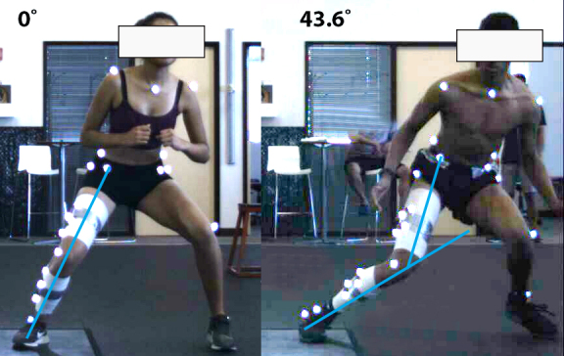

Slide 56
Patellofemoral pain
Compare peak maximum principal stress in the patellar tendon between persons with and without patellar tendinopathy during a simulated single-leg landing task
Compared with the control group, persons with patellar tendinopathy exhibited greater peak maximum principal stress in the patellar tendon and greater tibiofemoral joint internal.
Transverse plane rotation of the tibiofemoral joint was the best predictor of peak maximum principal stress in the patellar tendon
Park K et al Persons with Patellar Tendinopathy Exhibit Greater Patellar Tendon Stress during a Single-Leg Landing Task Med Sci Sports Exercise 2023 Apr 1;55(4):642-649. doi: 10.1249/MSS.0000000000003084. Epub 2022 Nov 17.

Slide 57
PFP and Increased Glut Max Activation
Atkins LT et al Physical Therapy and Rehabilitation 2021
Movement training that Increase gluteus maximus activation, and increased hip extensor moment lead to decreased dynamic hip internal rotation and significantly decreased PFJ pain.
The movement training was increased forward trunk flexion and increased hip flexion(instructed to sit back into a chair)
This movement training lead to 3 times increase in hip extensor moment
Kluger et al 2014 found the same 25 and 50 degree increase in trunk flexion lead to 133 and 211 increase in hip extensor moment in gait

Slide 58
Hip Extensor Moment and PFJ stress
Farrokhi et al 2008 increased trunk flexion lead to 33% increase hip extensor moment in single leg lunge movement.
Atkins et al 2021 the increased hip extensor moment in their study resulted in a 25% increase in glut max activation.
In the Atkins study increased trunk flexion from 13.7 degrees to 59.6, and hip flexion from 36.9 to 78.8
The increased hip extensor moment lead to a 79% decrease in PFP in this movement training
Movement training of the glut max in the sagittal plane resulted in kinetic change in the transverse plane

Slide 59
Hip Adduction With Running
Powers CM et al Med Sci Sports Exercise 2022
Evaluated 14 female and 15 male looking for predictors of hip, thigh adduction during running.
Used 3D camera, EMG, and CT scans of pelvis and hips
Femoral anteversion was the only significant predictor or peak hip adduction during late swing and stance.
Found that femoral morphology contributed more to adduction during running than hip abductor strength and activation.

Slide 60
ACL
Non contact ACL injuries especially in women has been on the rise.
In the literature it has been proven that if a increased or large valgus movement occurs during running, change of direction, cutting or landing there is an increased stress on the ACL.

Slide 61
ACL
Hansberger BL et al Journal of Athletic training 2018
Compared dancers (non professional) with 5 years experience to D1 athletes with at least 5 years experience in soccer or basketball
Did single leg jump landing to vertical jump
Female non dance athletes had greater peak ankle eversion, and less peak ankle dorsiflexion (ie, positions associated with greater ACL injury risk) compared with female dancers and male nondancers.

Slide 62
ACL
Hansberger BL et al Journal of Athletic training 2018: cont
Dancers and male nondancers consistently had higher peak ankle dorsiflexion and inversion, whereas female nondancers maintained a more neutral position with ankle eversion
Forefoot-first landings result in fewer ground reaction forces than do heel-to-toe landings
In this study they did not evaluate pelvis or torso position

Slide 63
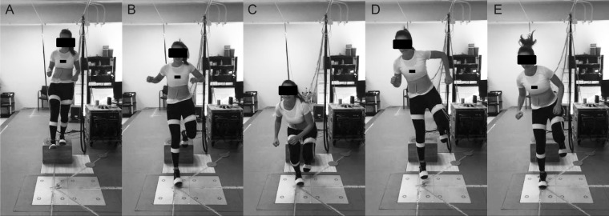

Slide 64
ACL Injuries
Female athletes have a 4-6 times higher incidence of non contact ACL injuries compared to men. Agel J et al 2005, Arendt E et al 1995, Numata H. et al 2018, Heebner NR et al. J Athl Train. (2017), Linde LD et al 2018
Women tend to land with less hip and knee flexion and have greater knee extensor moments, lower hip extensor moments and a higher knee/hip extensor moment ratio. Chapell JD et al 2007, Ford KR et al 2010,Decker MJ et al 2003, Shultz SJ et al 2009, Sigward et al 2011, Heebner NR et al. J Athl Train. (2017), Numata H et al 2018, Linde et al 2018, Sasaki et al 2019

Slide 65
ACL Injuries
Hewett et al; British Journal of Sports Medicine March 2009
Video analysis of trunk and knee motion at the time of ACL injury in Men and Women.
12 year period video tapes were evaluated.
Injured females athletes demonstrated increased lateral trunk motion and increased abduction angle at the knee more than uninjured females and male athletes.

Slide 66
ACL Injuries
The injured female athletes showed increased abduction during initial contact-landing sequence.
Controls (non-injured females) showed no change in abduction angle on contact.
Female ACL-injured athletes demonstrated less forward trunk lean than female controls.

Slide 67
ACL
Leppanen M et al Scandinavian Journal of Medicine and Science in Sports 2020
258 athletes 12-21 years of age, prospective study
Recorded non contact low extremity injuries for 12 months.
Looking for pelvic hiking when doing a single knee lift on contralateral side of injury
Increased pelvic hike was found to be a risk factor for ACL injuries among female athletes.

Slide 68
ACL
Improving the utilization of the hip musculature during the deceleration phase of landing and cutting maneuvers may decrease the reliance on knee extensors and passive restraints to eccentrically deceleration of the body’s center of mass. Powers et al 2006, 2010, Sasaki et al 2019

Slide 69
ACL
A study demonstrated radiographic evidence of knee osteoarthritis among 42% of female soccer players following ACL reconstruction within 10 years of the injury
Primary prevention is an effective way to reduce the adverse physical, psychological, and financial outcomes of this traumatic injury
Approximately 70% of all ACL tears occur with a non-contact mechanism
Female athletes have a two to eight times higher risk of ACL injury compared to their male counterparts
Lohmander, L.S. et al Arthritis Rheum. 2004, Swart, E. et al J. Bone Jt. Surg. Am. 2014, Boden, B.P. et al Am. J Acad. Orthop. Surg. 2010, Agel, J.; Olson et al J. Athl. Train. 2007, Mattu AT et al 2022

Slide 70
ACL
The combination of KAM( Knee Abduction Moment), ATS (anterior tibial shear), and ITR (internal rotation torque) increased ACL strain during drop landing simulations
KAM is the secondary external load that most increases ACL injury risk during landing.
ITR was the next load that increased ACL injury, when combined significantly increased ACL failure during landing
Navacchia A et al J Orthop Res. 2019

Slide 71
ACL
Larwa J et al 2021:
Did a systematic review of literature and video analysis of ACL injuries.
Areas most commonly seen as possible causative mechanics associated with ACL injuries:
Increased hip flexion esp at strike and through end loading
Increased hip adduction leading to increased valgus force on knee
Injured Females had delayed VMO firing compared to males on single leg drop.

Slide 73
ACL
Larwa J et al 2021: Continued
Landing in heal strike or flat footed vs more plantarflexion was associated with ACL injured athletes
Trunk displacement increased lateral trunk displacement, females took longer to stabilize, and were shifted more posterior in relation to center of gravity

Slide 74
ACL
ACL injury events revealed most (70%) injuries involve minimal to no contact and occur during landing or deceleration maneuvers with a minor perturbation before the injury that may disrupt the neuromuscular system leading to poor body dynamics.
A series of quantitative videotape studies demonstrated differences in leg and trunk positions at the time of NC-ACLI (noncontact-ACL injury) in comparison to control subjects
Analysis of the faulty dynamics provoking NC-ACLI, especially the flat-footed landing component, supports the theory that an axial compressive force is the critical factor responsible for NC-ACLI.
Both a strong eccentric quadriceps contraction and knee abduction moments may increase the compressive force at the joint thereby lowering the axial threshold to injury.
Boden BP et al Ortho Res 2022

Slide 75
Ankle Injuries
Lateral ankle injuries account for 85% of all sprains.
Ankle sprains are the most common sports related injury today (Garrick et al, Callaghan et al)
33% of patients with lateral ankle sprains have persistent residual symptoms 2 years after the initial injury (Freeman et al)

Slide 76
Lateral Ankle injuries
If the ankle is more dorsiflexed when inverted the talar dome will rotate and shift more laterally.
Possible causing an avulsion of the styloid process of the fibula and damage to the lateral talar margin. Along with the lateral ligaments of the ankle, ATF, Calcaneal fibular ligament and posterior talofibular ligament

Slide 77
Lateral ankle injuries
If the foot is more plantar flexed during inversion the medial talar margin is impacted.
The ATF superior fascicle is under the most stress.
The talus will rotate on the medial axis and shift anterior on the tibia.
Restricted dorsiflexion occurs as a result of the talus shifting anterior.

Slide 78
Micro Instability Lateral Ankle Injury
ATFL; the S-ATFL(Superior Fascicle Anterior Talofibular Ligament) is taut in plantarflexion while the I-ATFL(Inferior Fascicle Anterior Talofibular Ligament) in dorsiflexion.
The S-ATFL is considered as an intraarticular structure, while the I-ATFL is an extraarticular part.
Interconnections between the ATFL, CFL(Calcaneofibular ligament) and PTFL(Posterior Talofibular Ligament) causes the formation of an anatomical and functional lateral fibulotalocalcaneal ligament complex
Vega J et al The lateral fibulotalocalcaneal ligament complex: an ankle stabilizing isometric structure. Knee Surg Sports Traumatol. Arthrosc. 28, 8–17 (2020).Szaro P et al The double fascicular variations of the anterior talofibular ligament and the calcaneofibular ligament correlate with interconnections between lateral ankle structures revealed on magnetic resonance imaging NatureScientific Reports volume 10, Article number: 20801 (2020) Vega J et al Ankle Joint Microinstability: You Might Have Never Seen It but It Has Definitely Seen You Foot Ankle Clin. 2023 Jun;28(2):333-344. doi: 10.1016/j.fcl.2023.01.008. Epub 2023 Mar 27.PMID: 37137627

Slide 79
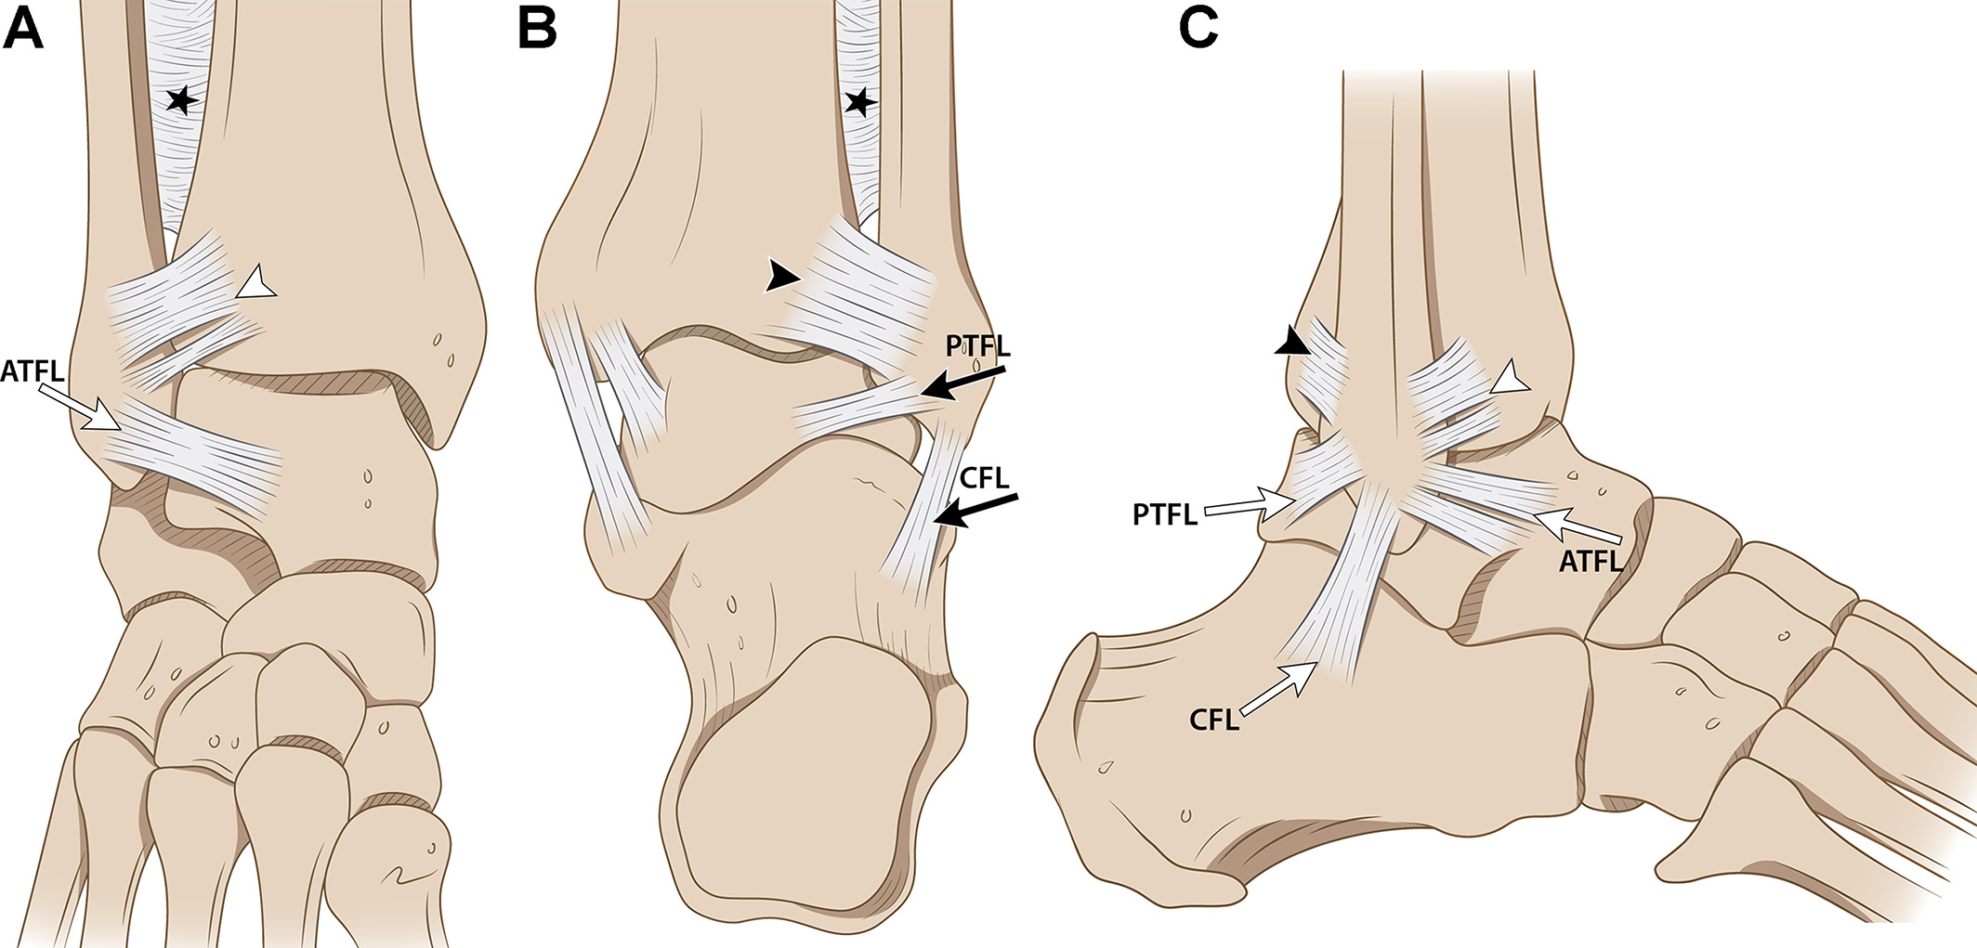

Slide 80
Micro Instability Lateral Ankle Injury
The arciform fibers between the I-ATFL and the CFL may play a mechanical role in stabilizing the ankle when tension shifts between these two ligaments
After the S-ATFL is torn, the tearing continues via the arciform connection to the CFL, and the patient may develop ankle instability
The newly named lateral fibulotalocalcaneal ligament is an isometric ligament, meaning that it is always taut, regardless of the position of the ankle joint.
Vega J et al The lateral fibulotalocalcaneal ligament complex: an ankle stabilizing isometric structure. Knee Surg Sports Traumatol. Arthrosc. 28, 8–17 (2020).Szaro P et al The double fascicular variations of the anterior talofibular ligament and the calcaneofibular ligament correlate with interconnections between lateral ankle structures revealed on magnetic resonance imaging NatureScientific Reports volume 10, Article number: 20801 (2020) Vega J et al Ankle Joint Microinstability: You Might Have Never Seen It but It Has Definitely Seen You Foot Ankle Clin. 2023 Jun;28(2):333-344. doi: 10.1016/j.fcl.2023.01.008. Epub 2023 Mar 27.PMID: 37137627

Slide 81
Ankle Sprains
The fibula migrates distally and translates medially in plantar flexion, ATF under more stress.
It (fibula) rotates laterally and migrates proximally in dorsal flexion to accommodate a wide anterior part of the talus into the widened space, allowing more rotation and the syndesmosis is under more stress.
Close JR et al 1956; Weinert CR Jr et al 1973

Slide 82
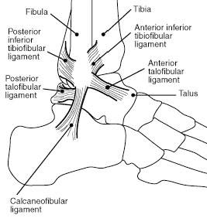

Slide 83
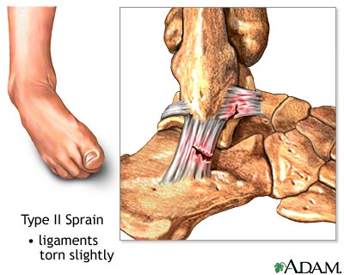
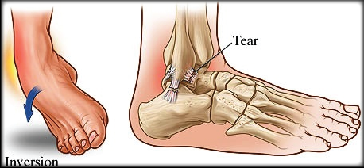

Slide 84
Evaluation of the lateral ankle
Review anatomy:
Palpation of the ligaments will be the most sensitive of your orthopedic evaluation.
Find the styloid process palpate look for pain along the tip or at the growth plate in a young person.
Directly inferior to the styloid will be the calcaneofibular ligament
Anterior to the styloid process will be the anterior talofibular ligament
Posterior to the styloid process will be the posterior talofibular ligament

Slide 86
High Ankle Sprains
High ankle sprain is caused by excessive external rotation of the foot with dorsiflexion and eversion (Wolfe et al.,2001; Xenos et al., 1995)
Another mechanism that stresses the Anterior Tibiofibular ligament is planted foot with internal rotation of the body and hip (Wei et al.,2011)

Slide 87
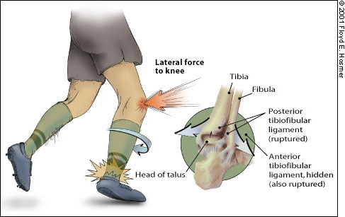

Slide 88
High Ankle Sprains
The distal tibiofibular syndesmosis contains 5 ligaments, the anterior inferior tibiofibular ligament (AITFL), posterior inferior tibiofibular ligament (PITFL), interosseous ligament (IOL), transverse tibiofibular ligament (TTFL), and the posterior intermalleolar ligament (PIML)

Slide 89
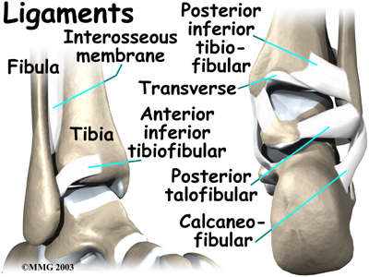

Slide 90
Treatment
Perform a Lumbar examination: looking for signs of low back dysfunction, pelvic dysfunction, neurologic signs etc…
Perform a hip examination looking for Impingement syndrome, labral injuries, bursitis, tendonitis, restricted hip flexion, internal rotation etc…
Look for hyperpronation syndrome in the foot specifically one side more than the other
Look for restricted motion in the tibia, internal and external rotation, often associated with hyperpronation.

Slide 91
Treatment
Normalize torso, low back, pelvis, and hip motion restrictions.
Normalize tibial rotation restrictions
Soft tissue to restricted areas consider that many of the injuries to the knee come from a frontal plane movement. Some of the injuries described today have a valgus defect associated with their onset.
If stability is needed use of specific braces or taping to unload the injured tissue.

Slide 92
Rehabilitation
Chan MKY et al BMC Musculoskelet Disord. 2017
Tested hip muscle contraction with bracing vs without bracing during 3 exercises.
Tested upper glut, lower glut, glut medius and bicep femoris activation during 2 versions of the clam shell and prone hip extension.
When abdominal bracing was performed increased %MCV occurred of the above musculature vs no bracing

Slide 93
Rehabilitation
From a biomechanical perspective, control of the lordosis during loaded activities such as squatting, running, jumping, and cutting is important to distribute forces efficiently between trunk the lower limbs and as well as to increase the tolerance of shear and compressive forces on the lumbar spine
Hides JA et al Journal of Athletic Training 2017, Aspden RM et al Clin Anat 1992, Claus AP et al Spine 2009, Bogduk N et al Clinical Anatomy of the Lumbar spine and Sacrum 2005

Slide 94
Rehabilitation
Chan MKY et al BMC Musculoskelet Disord. 2017 cont:
“The GMed, GMax and BF all have the muscle origin and attachment at various parts of the innominate bone and the femur”
“These findings indicated that the unwanted pelvic movements, which might contribute to the composite movement during hip exercises, would be minimized with abdominal core activation”

Slide 95
Rehabilitation
Chan MKY et al BMC Musculoskelet Disord. 2017 cont:
“The promotion of hip muscles activity in enhanced core condition is independent of the type of hip exercises.”
“The present findings suggest the potential benefit of abdominal core activation in enhancing the strengthening effect of exercises for rehabilitation of the lower limbs.”
“More enhancement in hip activation is correlated to higher physical activity level”

Slide 96
Rehabilitation
Tsang SMH et al J Electromyogr Kinesiol. 2018
“Enhanced IO/TrA contraction resulted in significantly greater activity in gluteus maximus, gluteus medius and bicep femoris at various phases of hip extension and clam exercises, single leg sit-to-stand and pelvic drop exercise”
“These findings indicate the presence of coactivation of the abdominal and hip muscles when performing the free active hip exercises. ”

Slide 97
Rehabilitation
Improving the utilization of the hip musculature during the deceleration phase of landing and cutting maneuvers may decrease the reliance on knee extensors and passive restraints to eccentrically deceleration of the body’s center of mass. Powers et al 2006, 2010, Sasaki et al 2019

Slide 98
Rehabilitation
Atkins L et al Physical Therapy and Rehabilitation Journal 2021
Increased Sagittal plane movement training of the hip and knee with increased utilization of Gluteus Maximus.
The participants were instructed to increase forward torso lean and sit back into the hips(like sitting into a chair). This increased the hip extensor moment. Increased hip extensor moment decreases knee extensor moment.

Slide 99
Rehabilitation
Atkins L et al Physical Therapy and Rehabilitation Journal 2021 cont
Increased training in the Sagittal plane decreases transverse plane movement.
Increased hip extensor moment training decreased pain in the patellofemoral group. 10 out of 17 participants in the pain group had complete resolution of their pain. Overall 79% reported decreased pain from movement training

Slide 100
Cortico Motor Excitability
Neurophysiologic feature representing the excitability measured from a peripheral muscle by applying a stimulation from a cortical region. (Rothwell 1997, TMS)
Early strength gains from training (less than 4-6 weeks) is attributed to increased CME.(Griffin & Cafarelli 2007a, Weier et al 2012)
Increased CME seen in increased muscle strength of tibialis anterior, soleus, rectus femoris (Beck et al 2007,Griffin & Cafarelli 2007a, Weier et al 2012)
Increased CME activity seen in increased muscle strength in Glut Max (Yani et al 2018)

Slide 101
Hip Rehabilitation
Powers et al 2010, 2020,Jenson et al 2005,
Motor skill training that emphasizes functional use of hip extensors can result in experience-dependent neuroplasiticity
Non skill training such as muscle strengthening has been reported to have no to minimal cortical motor excitability(CME)
Strengthening will increase movement capacity motor skill training would be required to make use of such capacity through the facilitation of CME

Slide 102
Hip Rehabilitation
Powers et al 2020 cont
Higher descending neural drive of Gluteus maximus(GM) was found to associated with greater functional use of the hip.
Specifically CME of GM was predictive of the average hip extensor moment and peak hip flexion during sport specific task. (one leg drop and jump)

Slide 103
CME
Shih Yo et al 2021 Human Movement and Science
Tested CME of Glut Max in healthy females vs males, they found females had less CME of Glut Max and less hip extensor torque compared to males.
CME was a good predictor of hip extensor torque and strength for males and females.
CME plays a role in the muscles ability to generate maximal torque

Slide 104
CME
Shih Yo et al 2021 Human Movement and Science cont;
Found that CME of the Glut Max was not dependent on the sex, male vs female
Higher CME in males was due to greater efficiency of the corticomotor pathway. This is trainable!!!
Exercise related neuroplasticity following long term use of a muscle was found in ballet dancers compared to non dancers (Saito et al 2014 in ankle flexors)

Slide 105
Rehabilitation of High Ankle Sprains
Activate the deep stabilizers of the foot
Ankle pronation with inversion while activation of the deep stabilizers
Pelvic stabilization exercises
Standing activation of the deep foot stabilizers while going into toe off
Hip exercises double and single leg

Slide 106
Rehab for high ankle sprains

