Slide 1
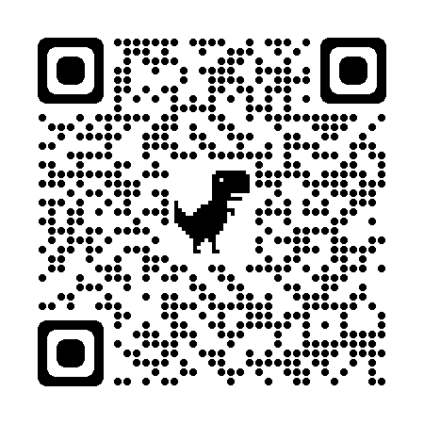
One Belly, Two Brains
John “Doc” Edwards, DC, DACCP

Slide 2
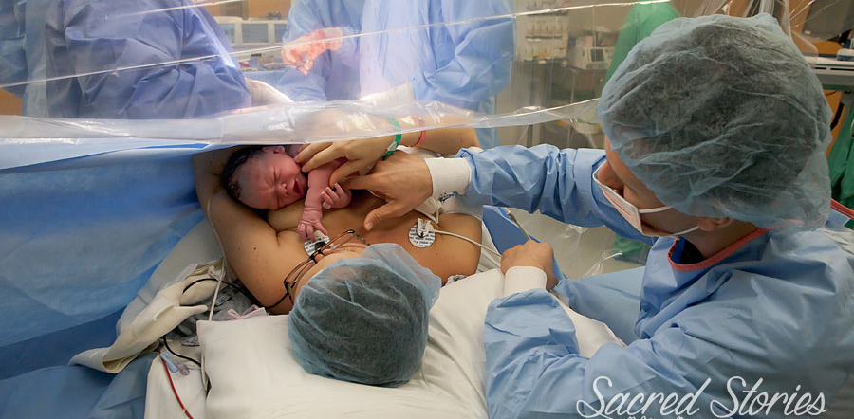
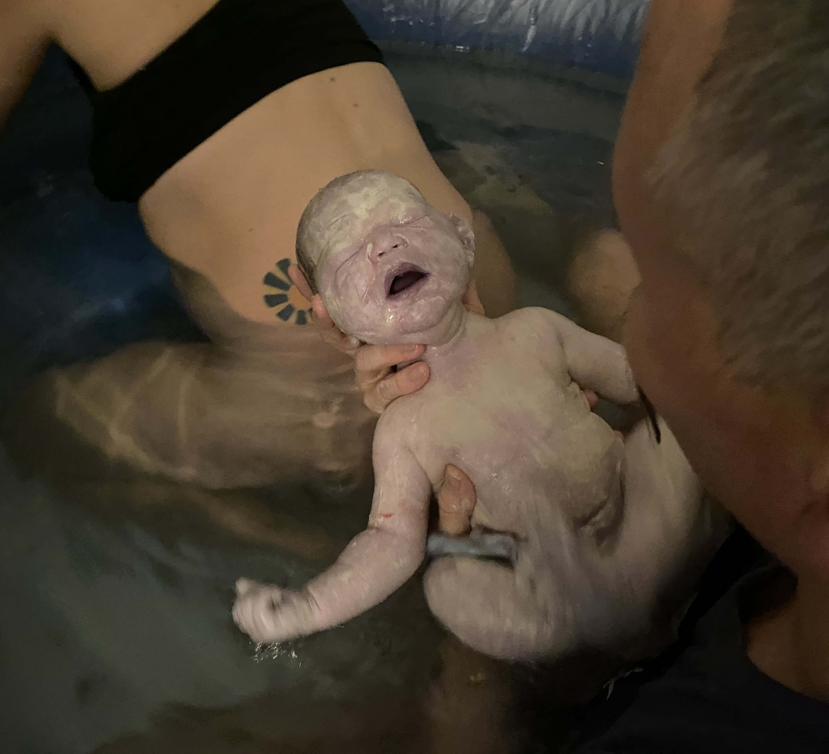
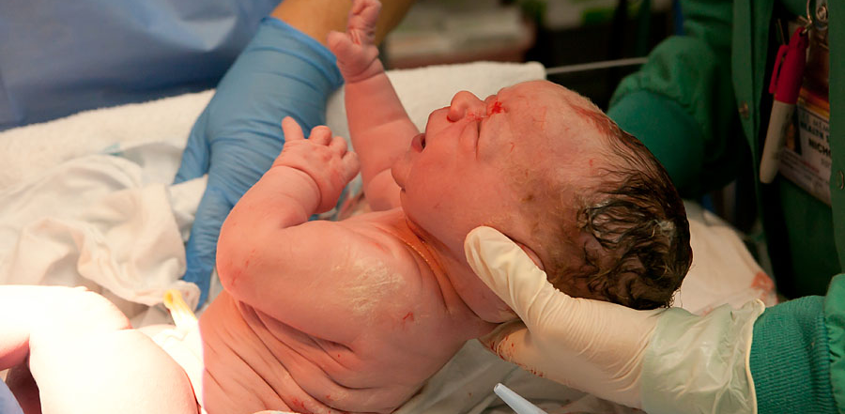
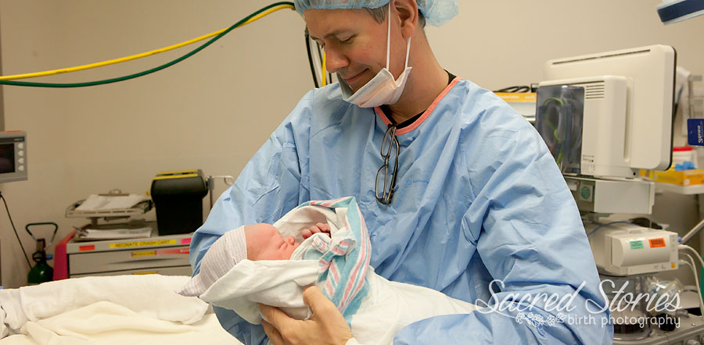
A Tale of Two Brothers
Forrest 12/17/2015
Charlie 02/16/2021

Slide 3


One Belly
OB
Pregnancy:
Cortical Function
ANS Indicators
Balance
Adjusting & Activities
PMADS

Slide 4
Two Brains
TB
Newborns:
The Emergency Reflexes
Top 4 Reasons
Latching Dyad
Polyvagal Ladder

Slide 5
Pregnancy
Webster 3&3, Edwards Addendum, U-T Angle, & P-SIJH

Slide 6
Next Level
Stone: Webster Technique
Edwards: Advanced Perinatal
Minardi: Thompson Technique
Thompson/Minardi: Logan Basic
Hosaka: Birth Biomechanics
Spinning Babies
Dynamic Body Balancing
Integral Touch of Birth

Slide 7
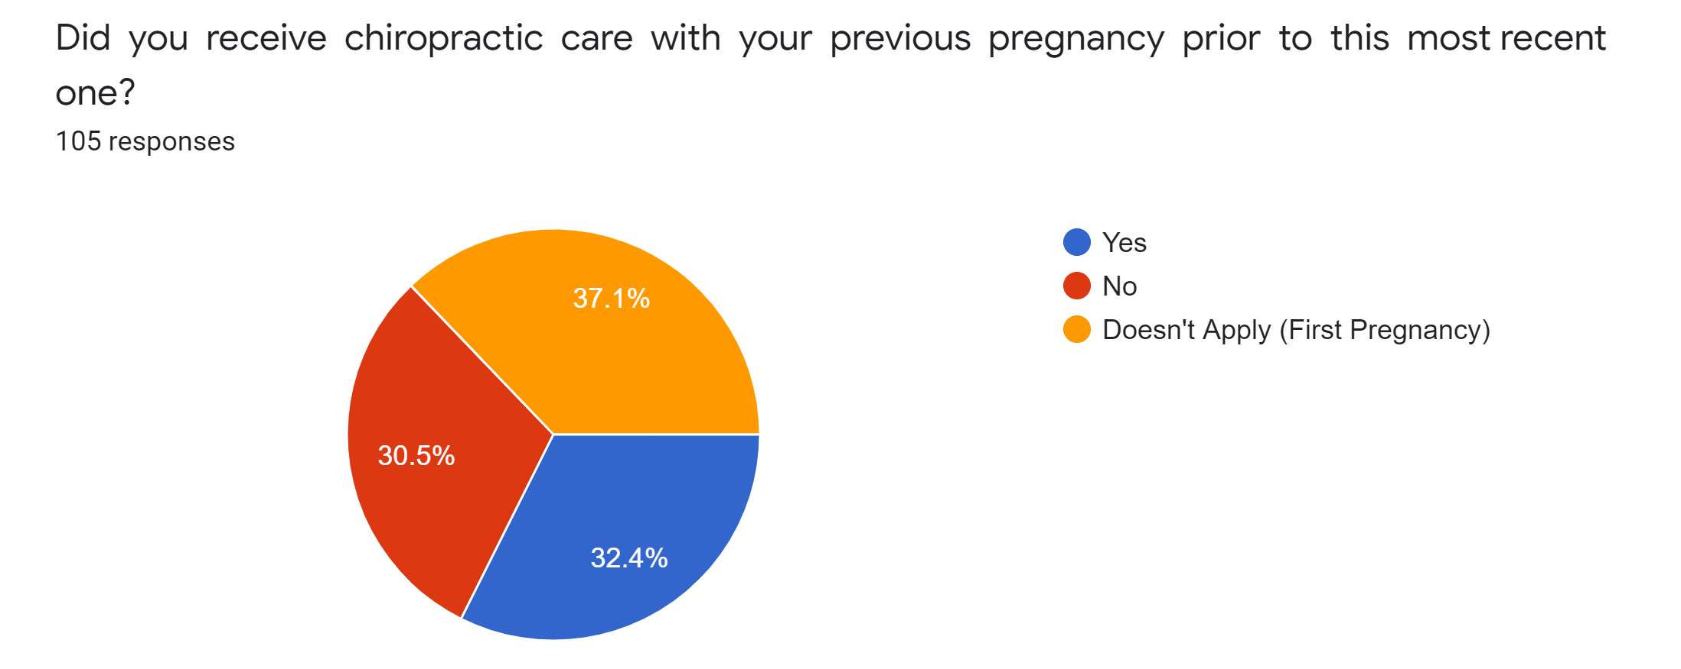
Pregnancy Patient Demographics

Slide 8
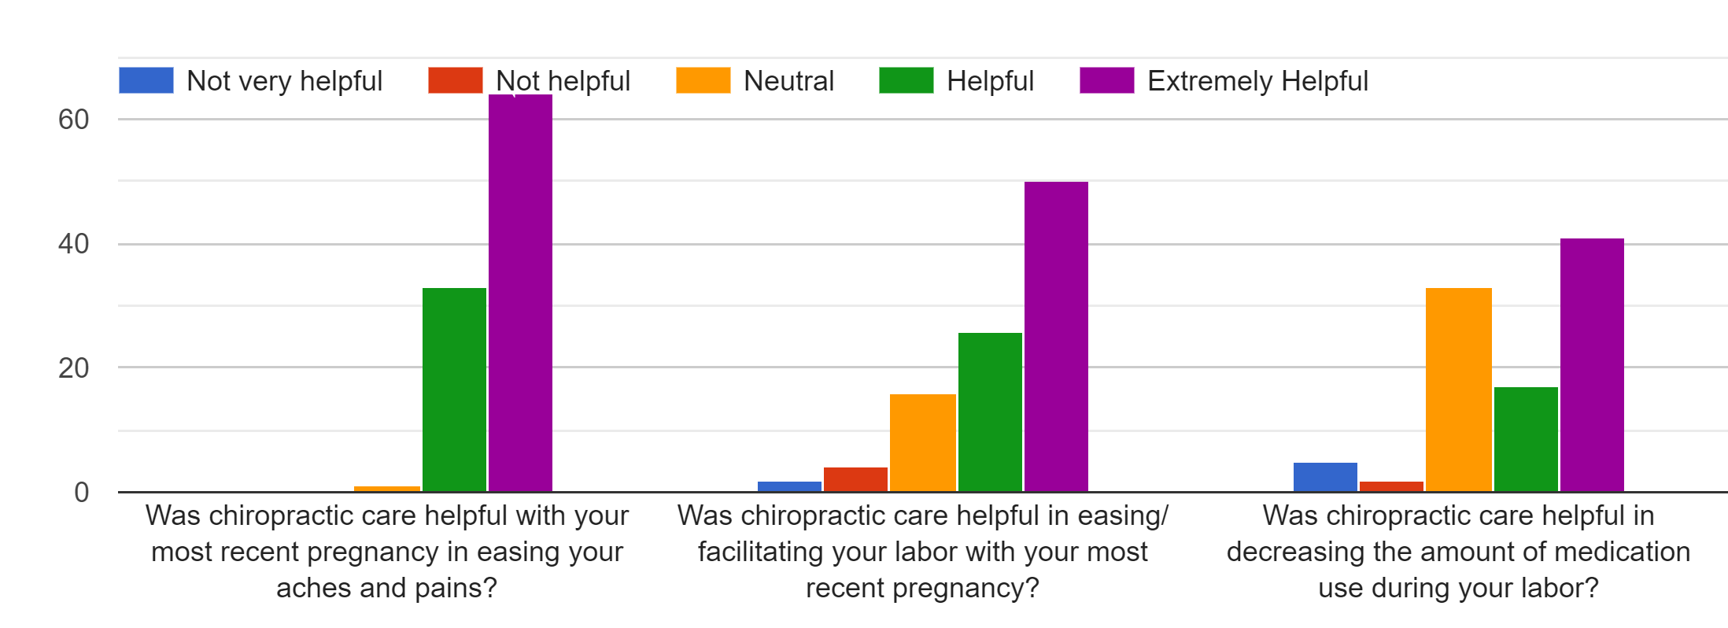
Did Chiropractic Care Help Your Pregnancy & Birth?

Slide 9
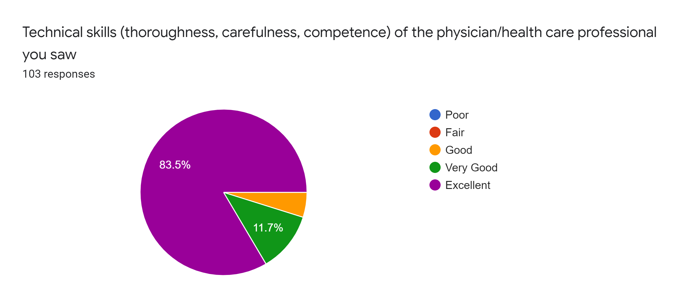
Rand VSQ-9

Slide 10
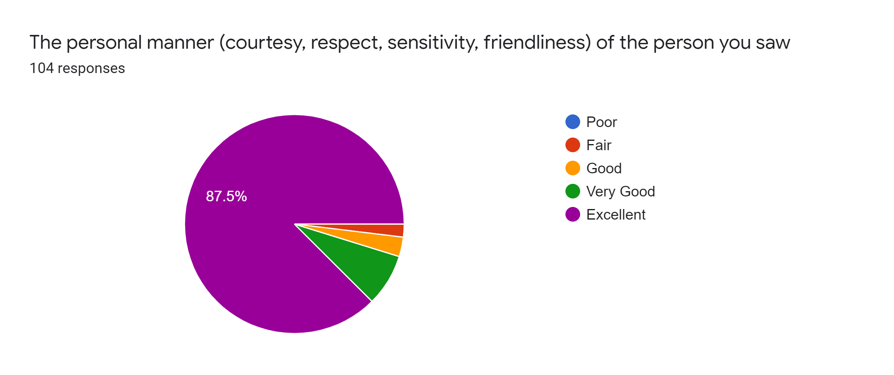
Rand VSQ-9

Slide 11

Do We Own Subluxation?
What’s the best way to detect it?
What’s the best way to clear it?
Are they able to be cleared?
Do you have new entities or recurring established ones?
What’s the best way to prevent them from recurring?
Are they a normal course of human existence or a pathology?
How often do they occur?
Are there other systems related to their presence?
Can you predict who is more likely to be prone to them?

Slide 12
Drywall Contractors vs Electricians?
Active Frontal Lobes Inhibit Flexor Tone
  “Default” state of SCM, Trapezius, Suboccipital Triangle, Medial Rectus, & Multifidi is flexion.
  Good brains inhibit that by 12 months as the frontal lobes develop, which also helps us stand upright.
Active Frontal Lobes Inhibit Sympathetic Nerve System Activity
  “Default” position ANS is Sympathetic for survival. Pupils dilate to “see” everything.

Slide 13
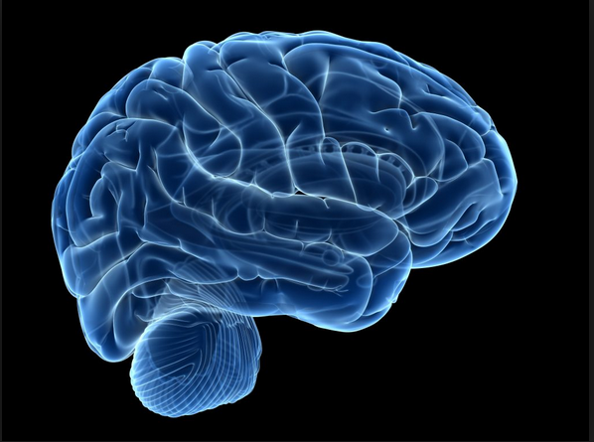
To jog your brains
Low tone in the frontal lobes leads to high tone in the same side flexors.
Low tone in the frontal lobes leads to unregulated SYM activity.
Stress hammers the frontal lobe.
Can brains cause subluxations?
The cortical (Frontal, Parietal, Temporal) Lobes get fed by their opposite side cerebellum.
Neurons like oxygen, glucose, and activity
How can you activate the side of cerebellar low tone, or opposite the side of cortical low tone, through adjustments?

Slide 14
Keep handy…
Penlight (You can use your phone’s flashlight on the lowest setting)
Pen and a piece of paper
Space around your chair for standing & moving

Slide 15
Perinatal Functional Outcome Assessment
Posture
Head tilt: to high flexor/low neuro tone side, or…
high point is the active cortex

Slide 16
Perinatal Functional Outcome Assessment
Functional Neurology Examination
Assessing ANS Tone through the eyes
Hypermetric
Hypometric

Slide 17
Assessing Cortical Tone
Saccade
Pursuits
Accommodation
Pupillary Latency
Convergence
Eye Motion

Slide 18
Building the LLL Case for “Low Tone”
Horizontal Pursuit
Hypometric
Same Side Parietal
Opposite Cerebellum
Hypermetric
Opposite Cerebellum

Slide 19
Building the LLL Case for “Low Tone”
Diagonal Pursuit
Hypometric
Up-side Cerebellum
Hypermetric
?

Slide 20
Building the LLL Case for “Low Tone”
Horizontal Saccades
Hypometric
Opposite Frontal
Same Cerebellum
Hypermetric
Same Cerebellum

Slide 21
Building the LLL Case for “Low Tone”
Low Cortical Tone
Head Tilt/ High Shoulder
Pupillary Latency
Poorly Converge
Hypotonic Pursuit
Hypotonic Saccade (opposite)
……

Slide 22
Perinatal Functional Outcome Assessment
Functional Neurology Examination
Assessing ANS Tone through the eyes
Hypermetric
Hypometric

Slide 23
Assessing Cerebellar Tone
Straight/Random Finger to Nose (E.O./E.C.)
Dysdiadochokinesia
March Series (Homo/Hetero, Fakuda Unterberger)
Coordination Tests (Dyskinesisa)

Slide 24
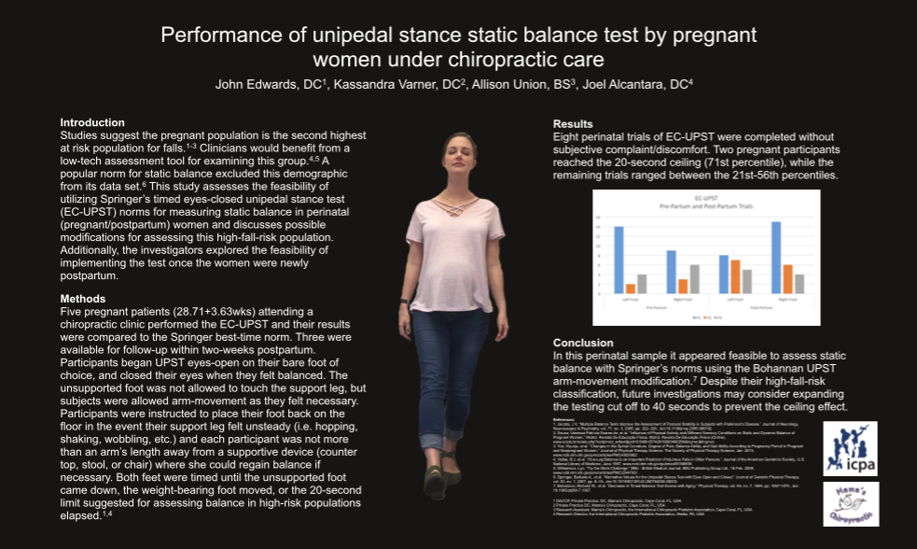
Perinatal Functional Outcome Assessment:
Advanced Romberg and Stork Stand
Unilateral Stance Norms
99th percentile: 30 sec
70th percentile: 20 sec
Sub 50th: 15 sec
Performance of Unipedal Stance Static Balance Test by Pregnant Women Under Chiropractic Care. Journal of Chiro Ed 2018

Slide 25
Building the LLL Case for “Low Tone”
Low Cerebellar Tone
HYPERtonic Field of Gaze
HYPOtonic Fields of Gaze
Bad Diagonal Pursuits
Dysmetria
Dyskinesia
Poor Balance

Slide 26
Assessing ANS Tone Through Vitals
Blood Pressure
Heart Rate
Respiratory Rate
Pulse Oxygenation
Chest Expansion
Heart Rate Variability

Slide 27
Building the LLL Case for “Low Tone”
Low Cortical Tone
Head Tilt/ High Shoulder
Pupillary Latency
Poorly Converge
Hypotonic Pursuit
Hypotonic Saccade (opposite)
SYM ANS
Low PO2

Slide 28

Brain Break!

Slide 29
Post-Natal
Polyvagal Theory, Perinatal Mood & Anxiety Disorders, & Adjusting/Activities

Slide 30
Next Level
Santos: Highs & Lows
Elmer: Postpartum Care (Container)
Gentile: Measure What Matters: HRV & Polyvagal
Warren: Perinatal Psychology
Carrino: Reducing Risk in Family Practice
Schaeffer: Epigenetics

Slide 31

Intuition: Pregnancy’s Sixth Sense

Slide 32
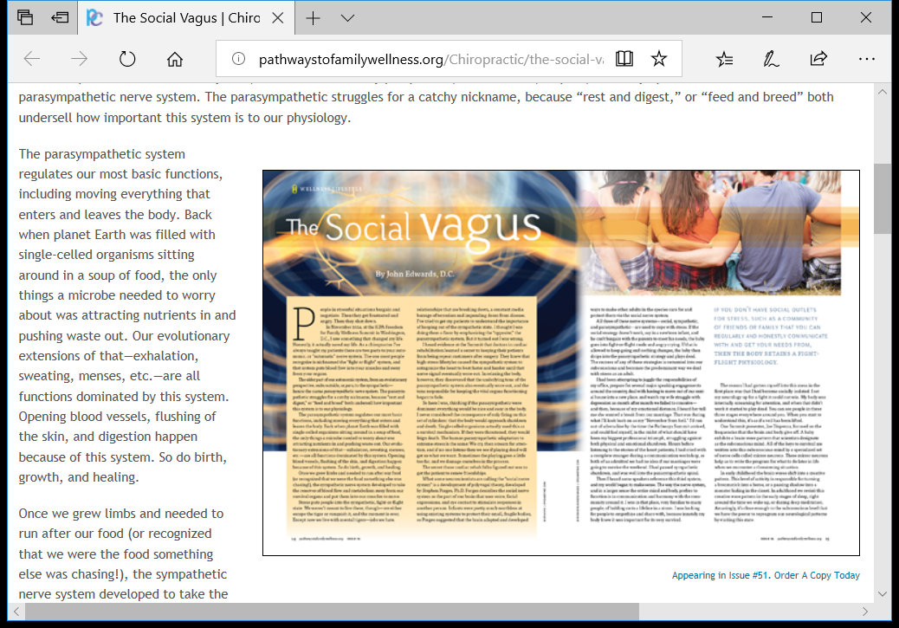
The Polyvagal Imperative
Braden, Dispenza, & Lipton in “The Panel That Changed the World”
“Hear My Cry”
“Pregnancy and the Sixth Sense”

Slide 33

Delta Wave Programming and You
Polyvagal Theory- Steven Porges, PhD
Delta- Subconscious
Alpha- Creative
Beta- Rational

Slide 34
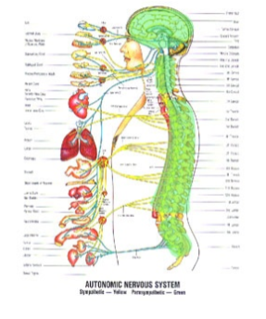
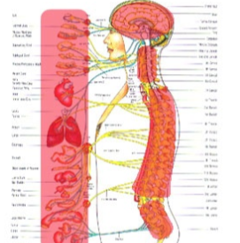
Delta Wave Programming and You
Social Vagus- Hey Mom! (Dunstan Baby Language)
Sympathetic Vagus- Mom! Mom! Mom!
Parasympathetic Vagus- Let’s see how this goes...

Slide 35
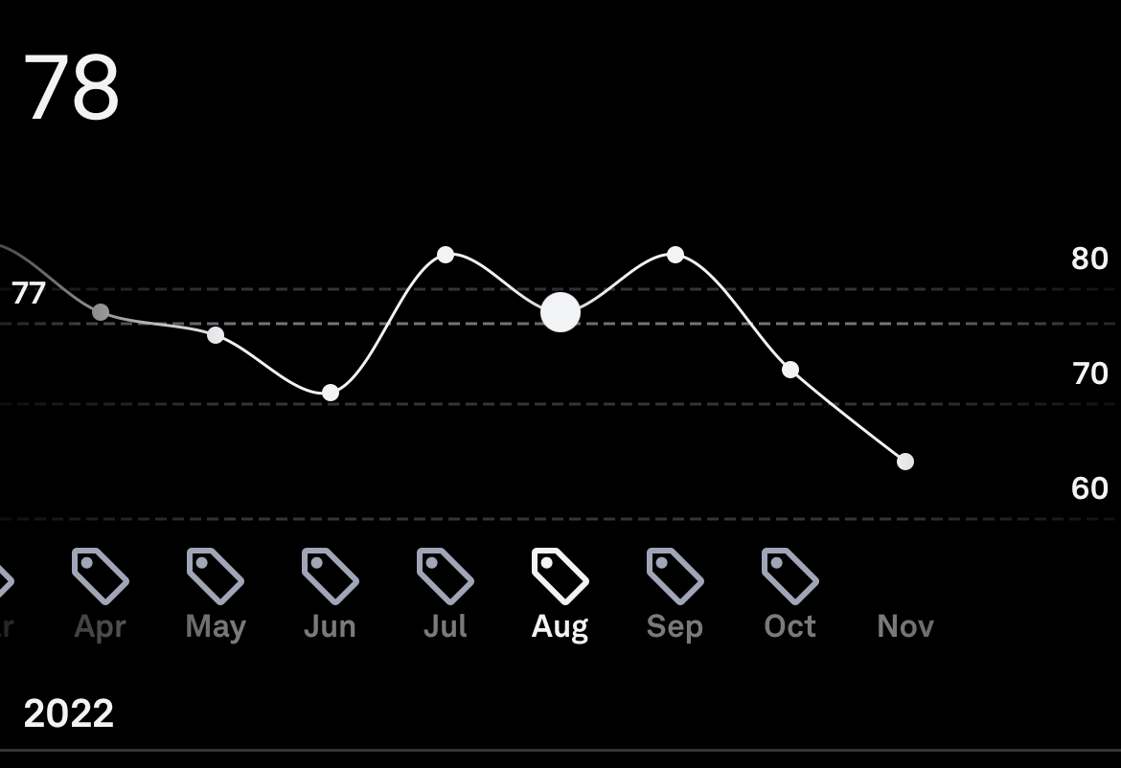
Heart Rate Variability
Variation in the time between beats is an indicator of health
Sleep, Eating, Exercise, Stress Management, Illness, Sex, Ovulation, Pregnancy Impact HRV

Slide 36
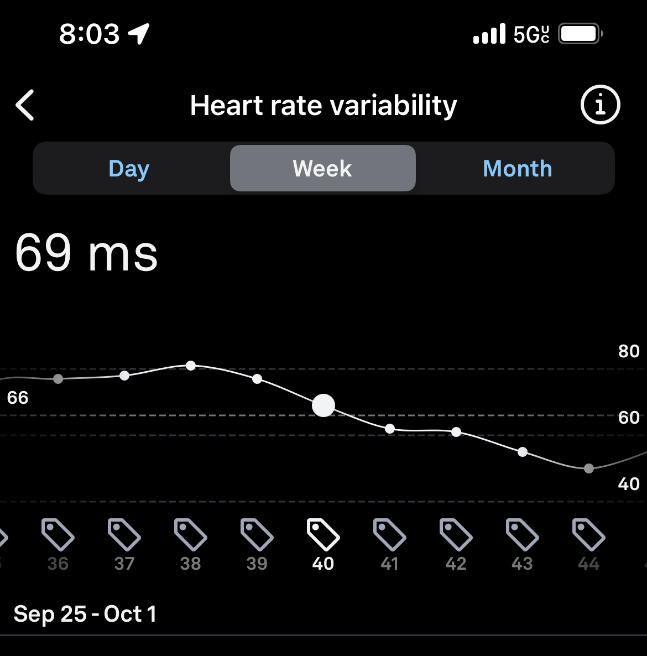
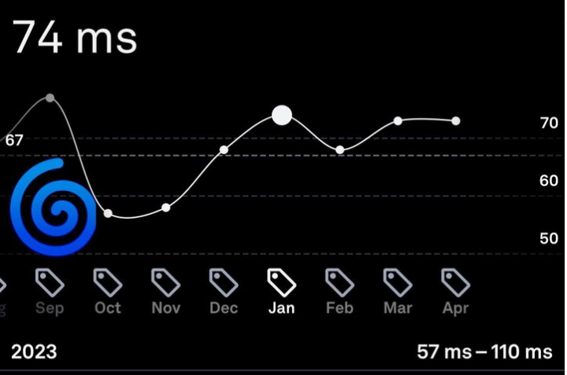
We Miss What We Don’t Measure
Oura Ring: Ultra low EMF device to measure HRV

Slide 37

Neuroception as the “sixth sense”of intuition
N
does carrying a child heighten this sense?
Is my environment SAFE?
Is my environment THREATENING?
Is the sensory perception accurate or inappropriate?

Slide 38
Perinatal Mood and Anxiety Disorders
Impacting 1 in 7 pregnancies, they’re the most common condition of the perinatal period.

Slide 39
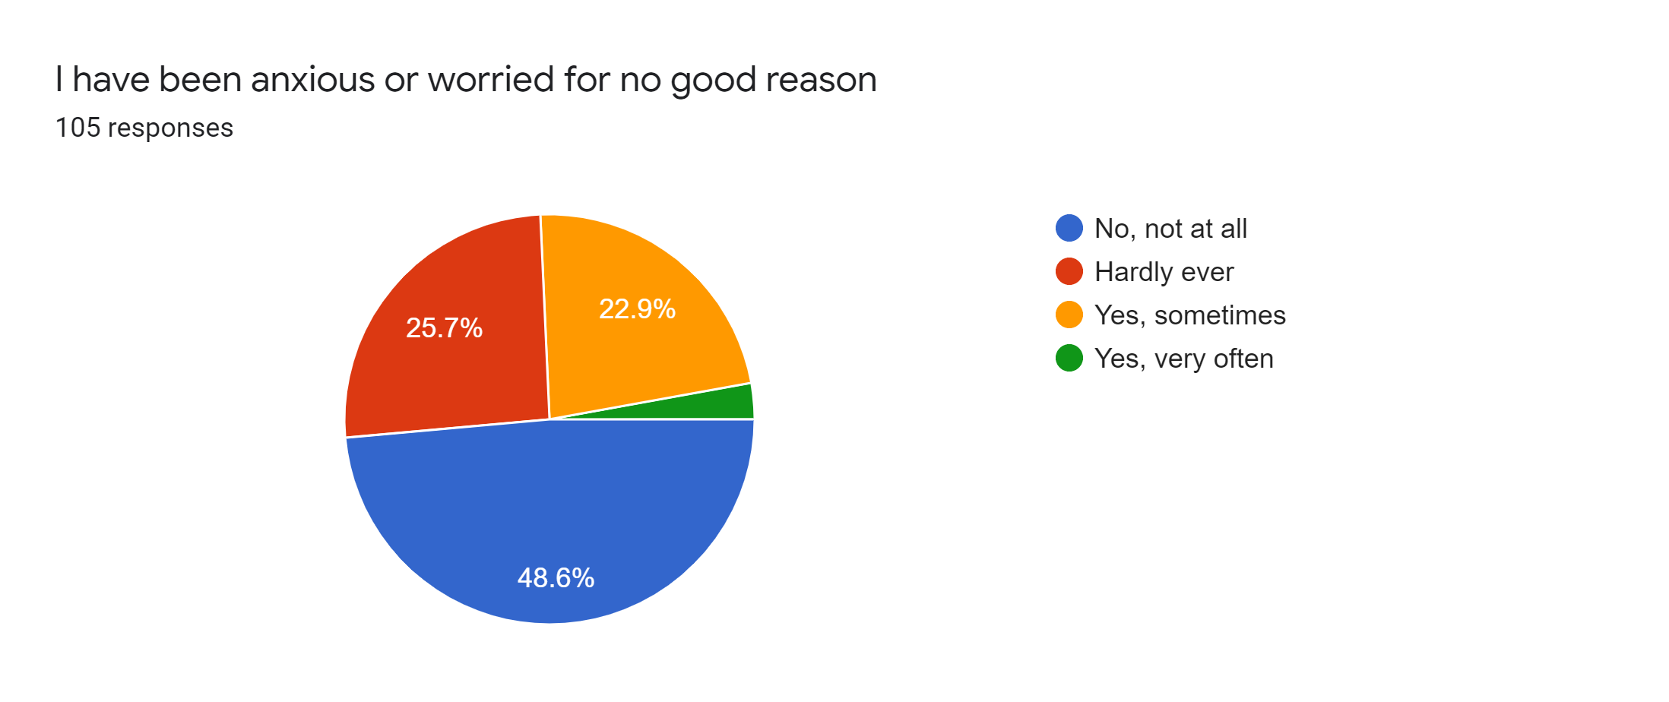
Edinburg Postnatal Depression Scale

Slide 40
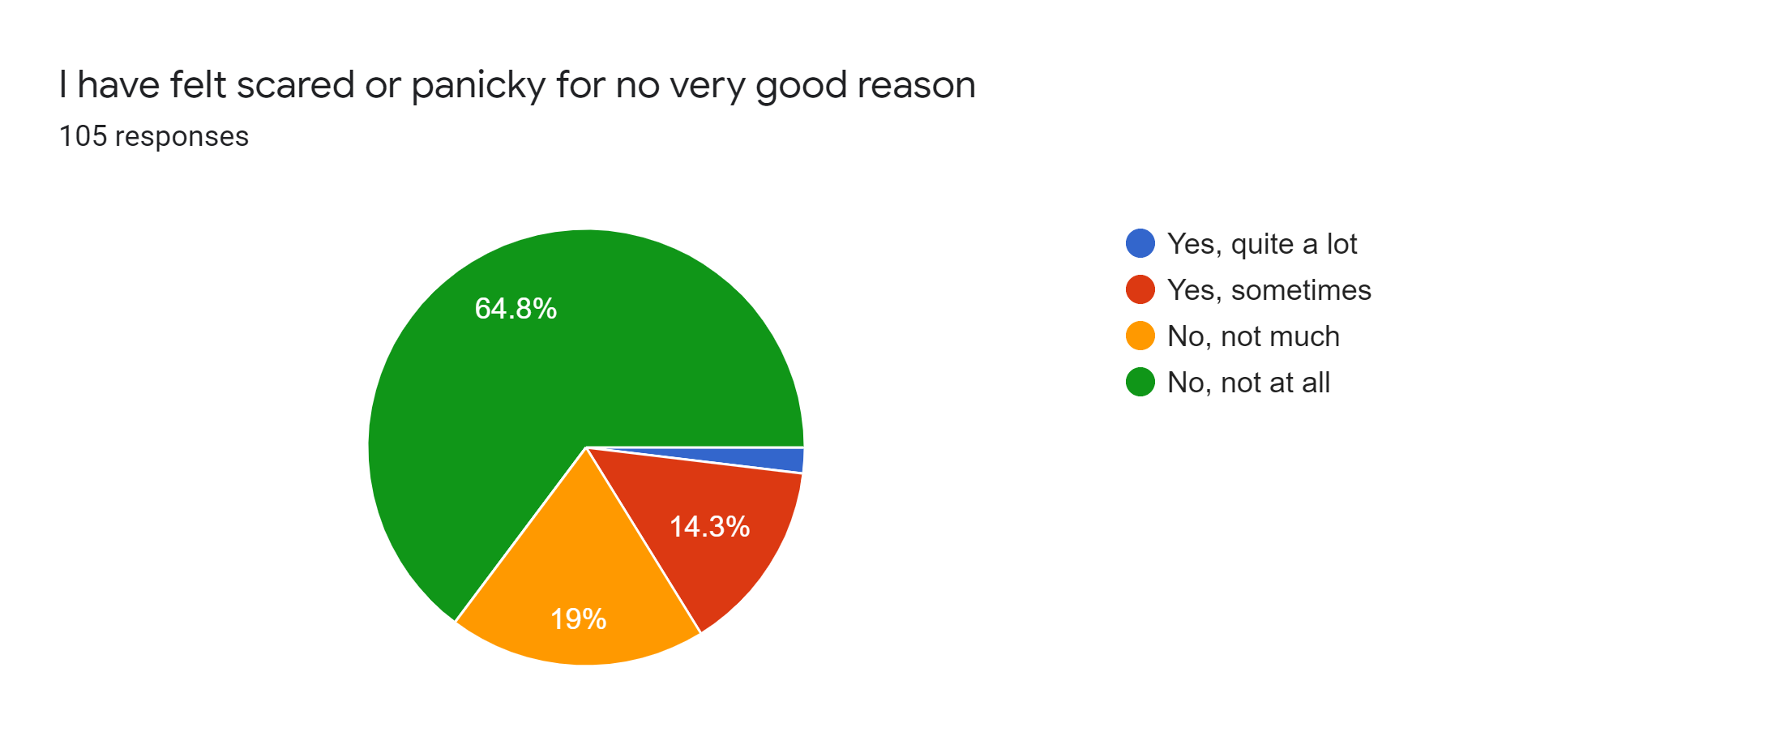
Edinburg Postnatal Depression Scale

Slide 41
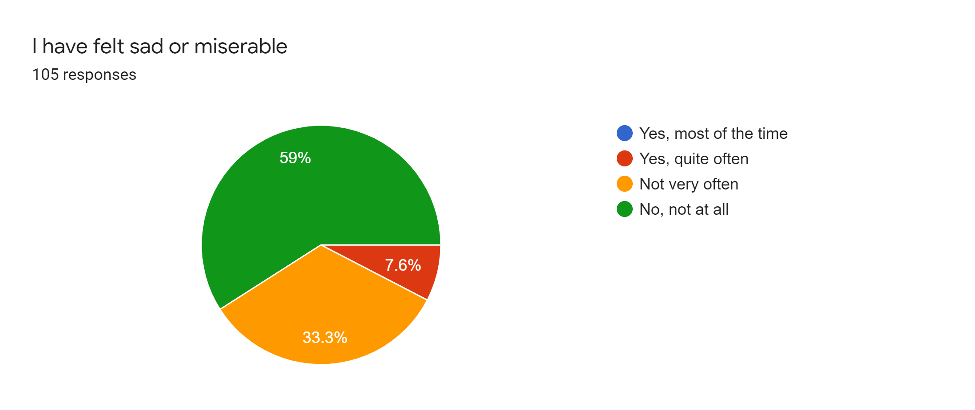
Edinburg Postnatal Depression Scale

Slide 42
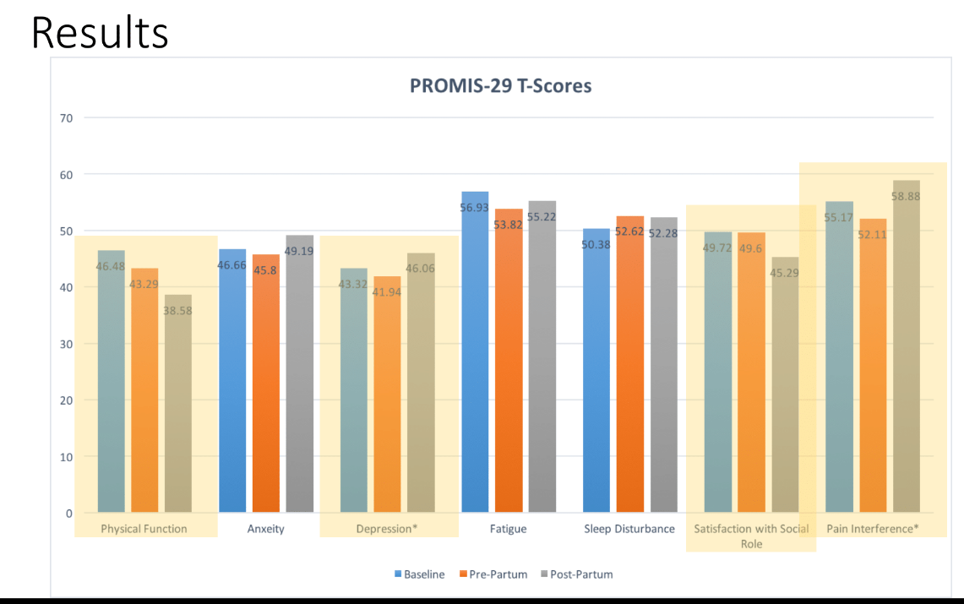
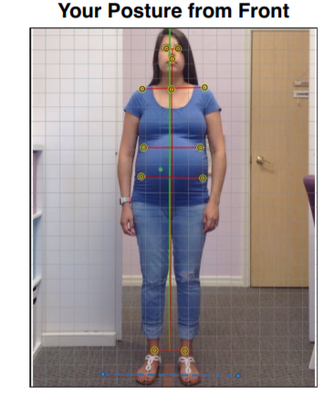
Perinatal Mood & Anxiety Disorders
Postpartum Depression, Anxiety, Anger, Psychosis

Slide 43

Clinical Application of Cortical Balancing Activities
Right Cortical Low Tone: Left Panning, Core & Erectors, Squats
Left Cortical Low Tone: Right Panning, Laterality, Squats
Cerebellar Low Tone: Balance, Coordination, Squats

Slide 44
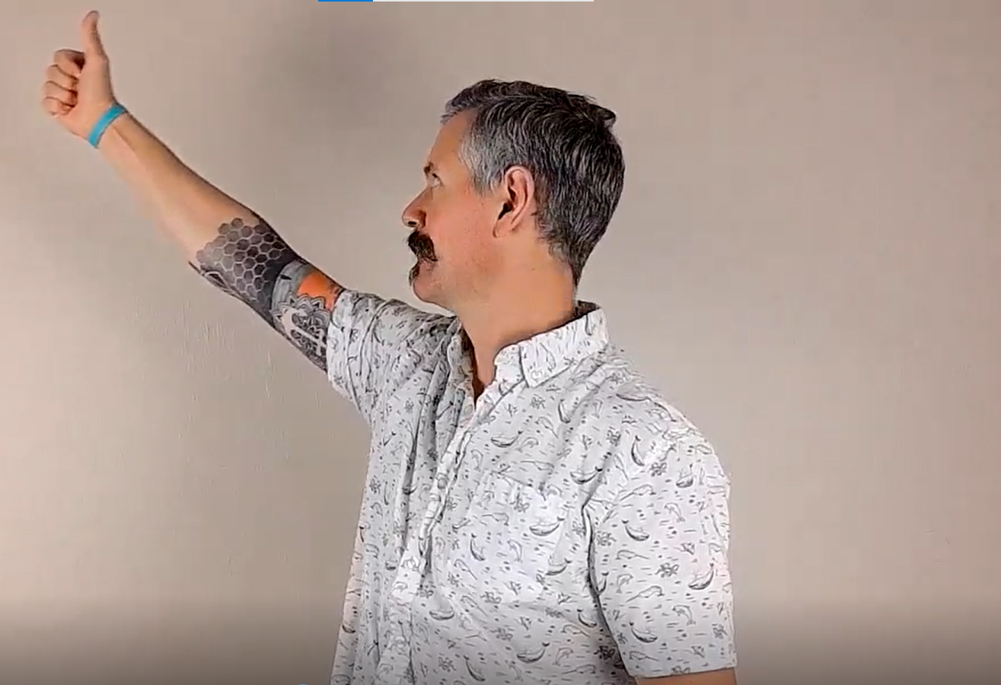
Panning
First Determine Side of Cortical Laterality (Low Tone)
Panning is going to be done with the hand opposite of that
“Airplane Hitch hiker”
Lead with the eyes
Can be done Standing or Prone on a ball

Slide 45
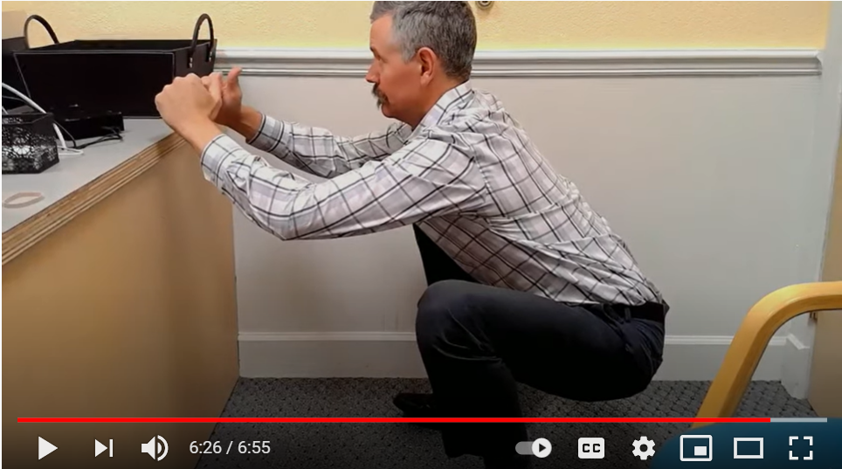
Vertical Shin Squat
Big Toe, Little Toe, and Heel In the ground like claws
Vertical Shins, Knees DO NOT travel over the toes
“Pinch Point” at the hips is a cue to abduct & externally rotate the thighs
Knees spread out to the sides
Maintain neutral pelvis
Torso Up
May need a box/chair to begin with

Slide 46
New Humans
Emergency Reflexes, Top 4 Reasons, Latching Dyad, Polyvagal Ladder

Slide 47
Next Level
Rossi/Shtulman: Pediatric Practice
Castellucci: Pediatric Technique
Malone: Cranial Adjusting
Rosen: Cranial Adjusting
Gerner/Dorough: TOTs & Latch
Libs: IBCLC & Mom’s Side
Hall: Pediatric Neurology
Rubin: Polyvagal Pediatrics

Slide 48

Check a Baby, Save a Life

Slide 49

Cervical Righting Reflex
Brainstem level reflex
Brain’s Map: Head = Torso
Turn the Head, Opposite Shoulder Lifts
If Positive= No Unsupervised Tummy Time
Resolution: 1 adjustment to 2 weeks

Slide 50
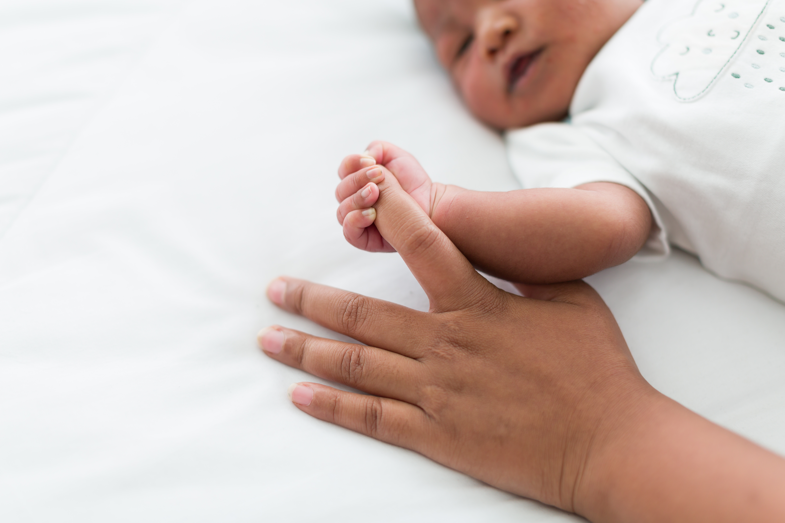
Pull to Sit Reflex
40% of all newborns receive a subclinical subdural hematoma, regardless of birth method
100% “Resolution” at 3 months. Those Milestones, Though!
Low cortical tone = hypertonic flexors
Brain Map: Head = Torso
Left, Right, or Straight Back?

Slide 51

Pupillary Latency
Pupil that reacts to light, then dilates.
Neurotypical to have left larger than right
Low cortical tone = SYM dominance
What else might you see?

Slide 52

Top 4 Reasons

Slide 53
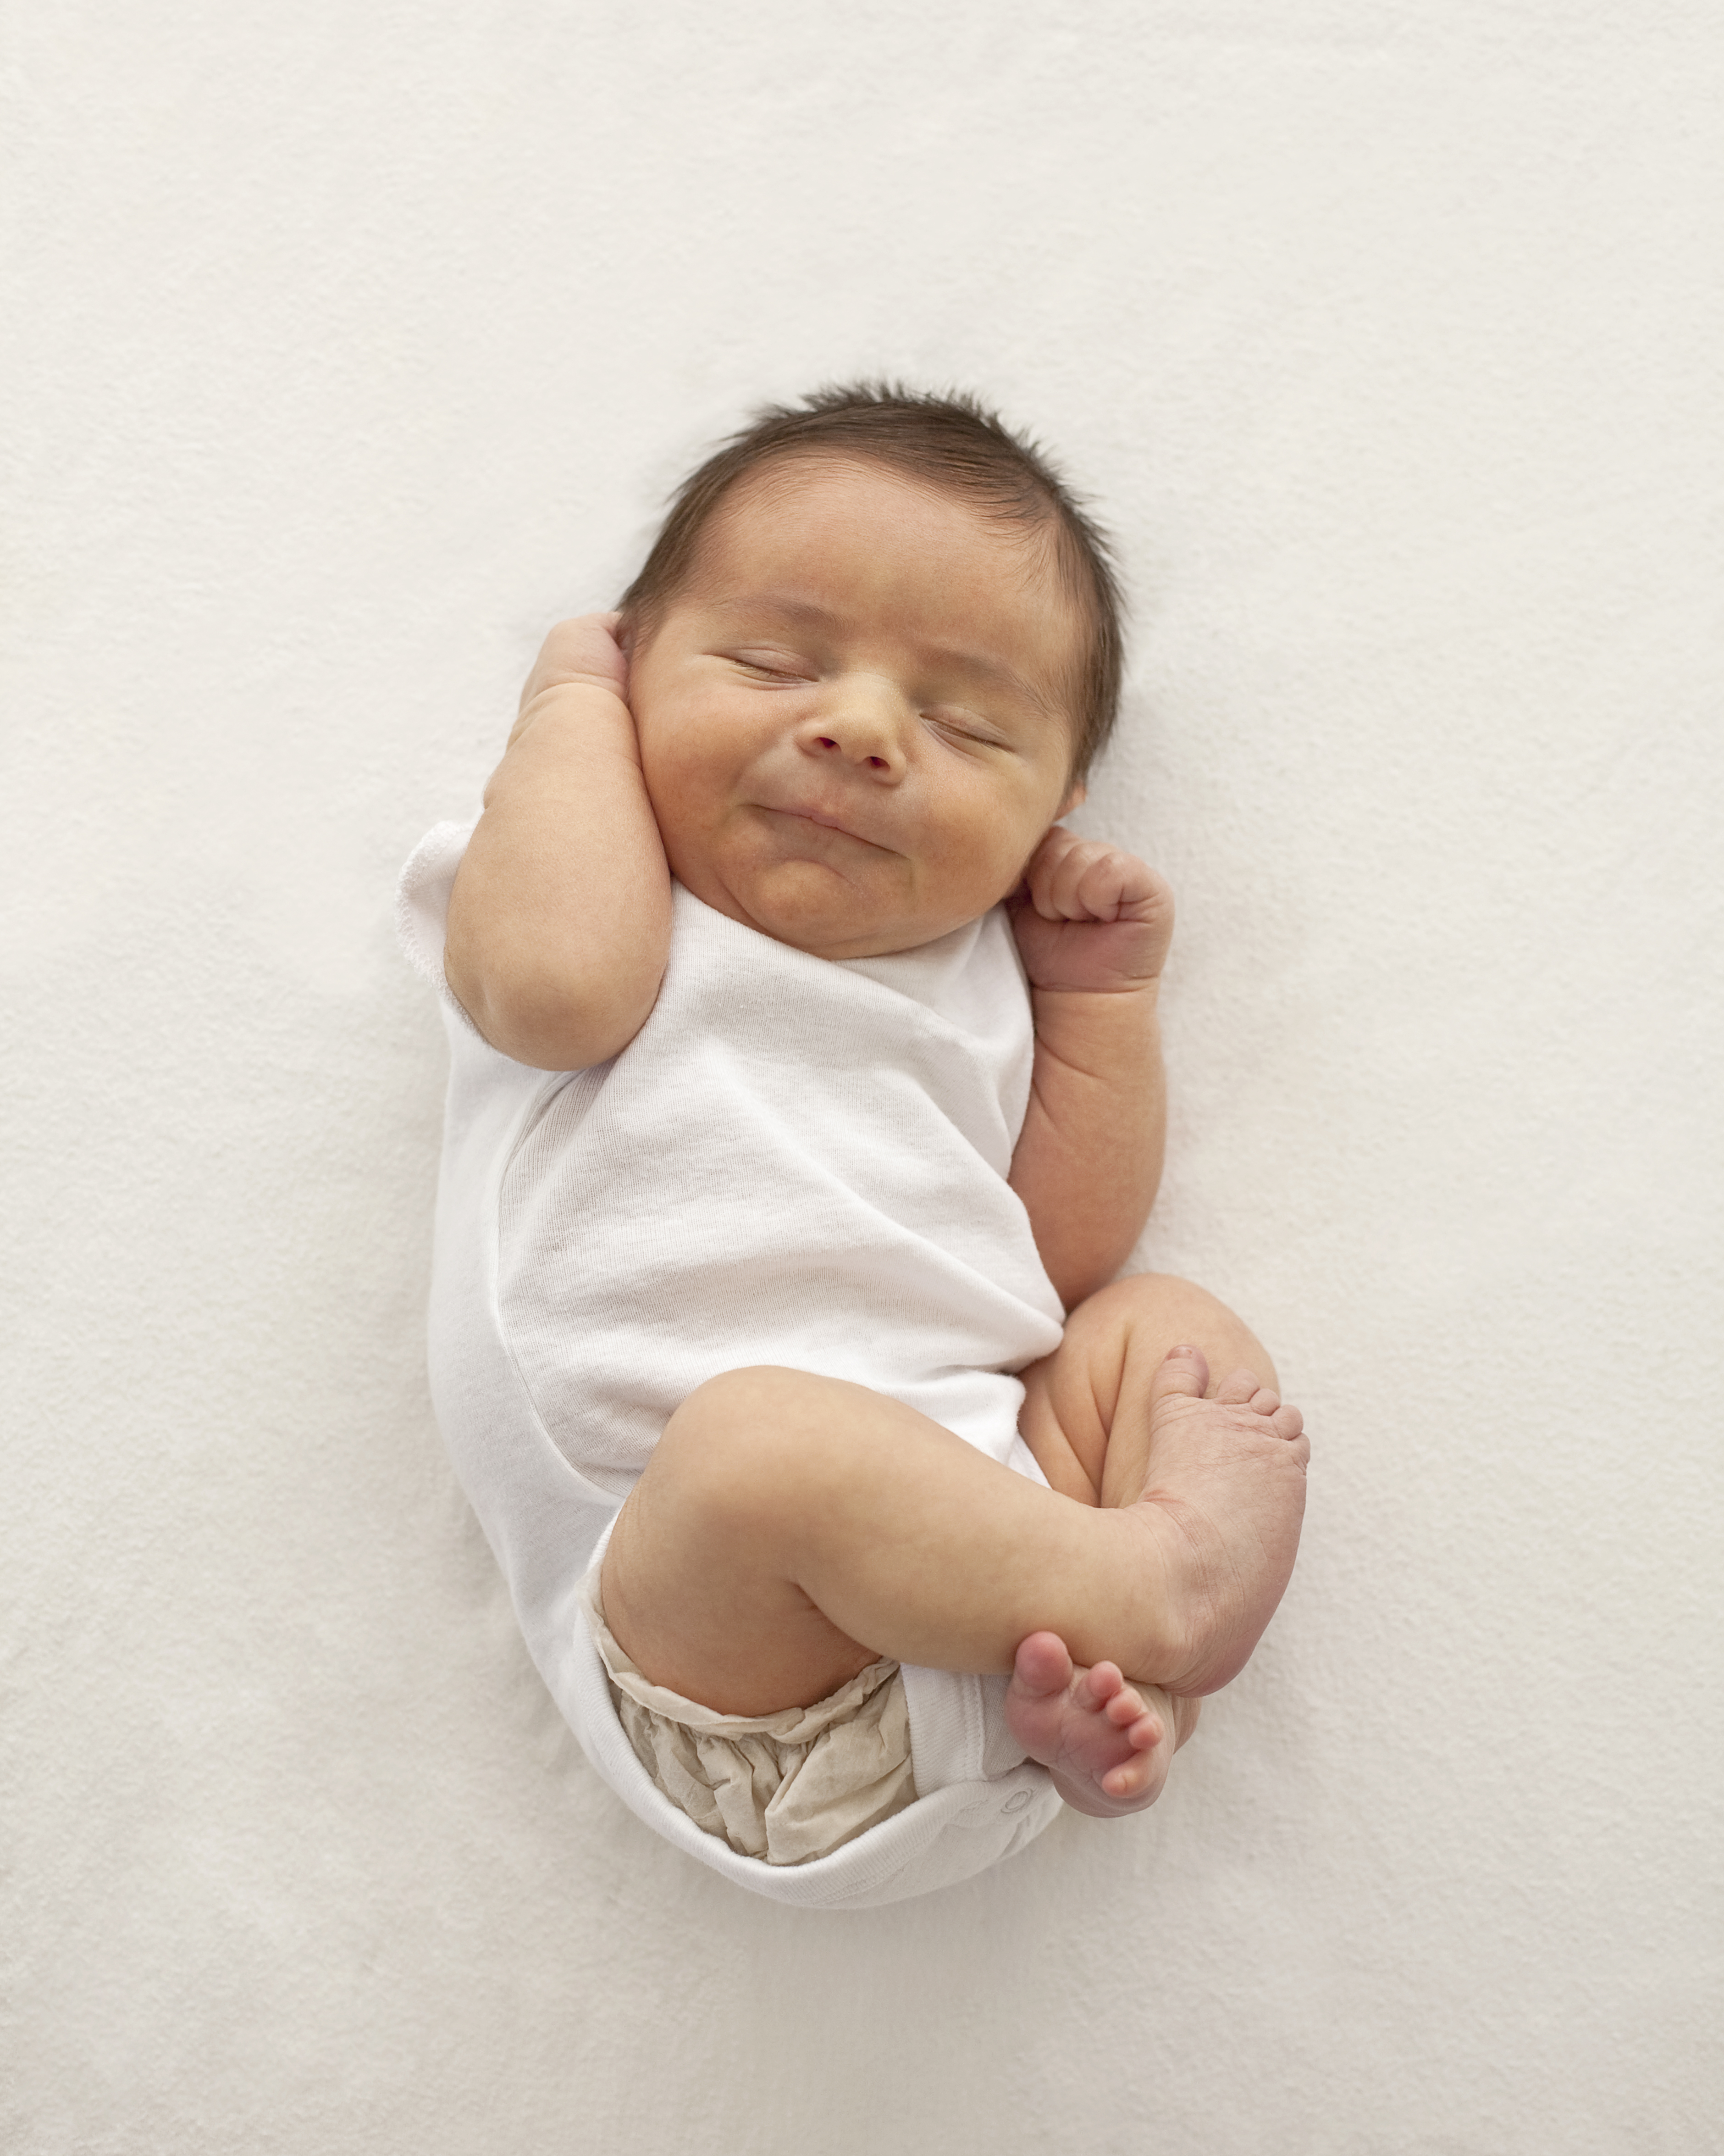
1. Head Tilt Even After Straightening
To feed a cortex, look for opposite subluxation opportunity
Finger in Chilled Butter
Dural/Fascia Unwinding: Occiput and Pelvic Contact
Logan Basic vs Sacral Pump
Swallowing, Digestive Challenges from Cranial Nerve Facilitation

Slide 54

2. Difficulty Turning Head To One Side
In Uterine Constraint or Birth Trauma?
Nursing side preference (football hold)
Temporal, Occipital, and Sphenoid
Tummy Time on Ball

Slide 55
Cranial Motion 101

Slide 56

3. Difficulty Settling or Sleeping
Checked for Low Tone
Dunstan Baby Language
5 Relaxation Reflexes
Pre-digested vs Post-digested Reflux
Probiotics
The Big 4 Foods

Slide 57

4. Experienced Trauma During Birth
Very short labor
Very long labor
The use of Pitocin to strengthen/induce uterine contractions
Pain medications
Restricted maternal birthing positions
Pulling or twisting on the head to deliver the infant’s body
The use of forceps or vacuum extraction
Cesarean delivery

Slide 58
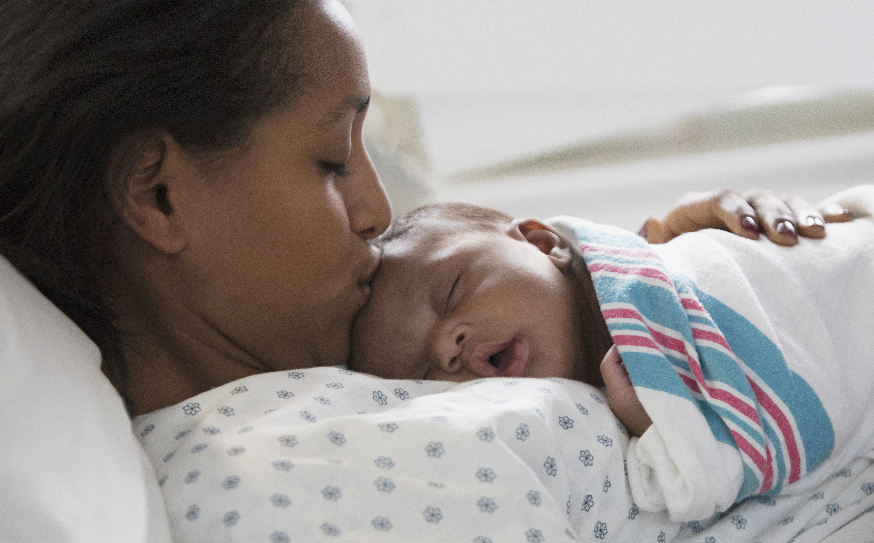
Nursing Dyad: Mama

Slide 59
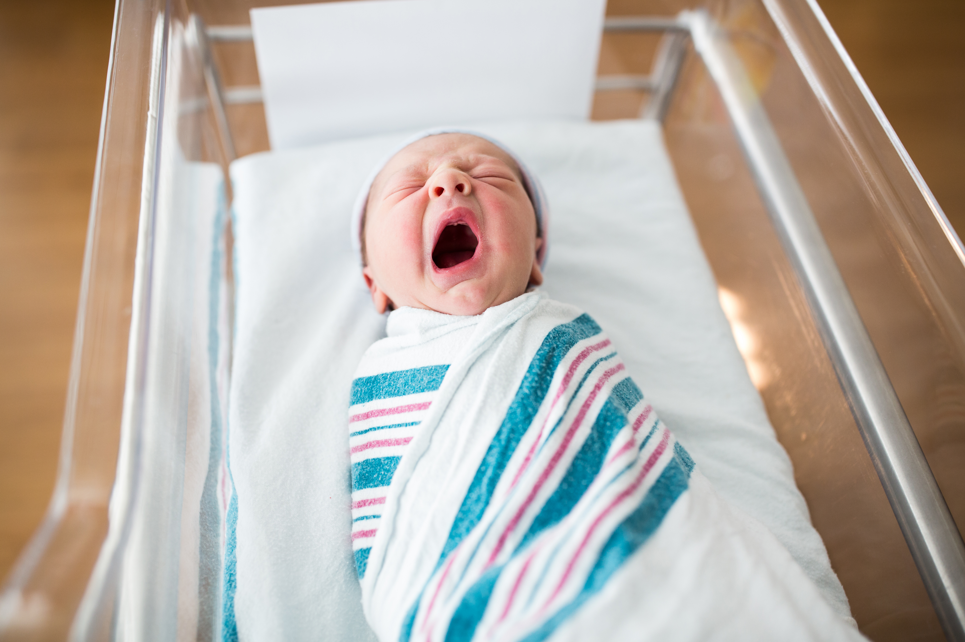
Nursing Dyad: Baby’s Latch

Slide 60

Returning to the Polyvagal Ladder

Slide 61


